Slide 1

Anesthesia Reimbursement for New Providers
Copyright 2025
Stephen D. Smith MA, CRNA, FAANA
All Rights Reserved

Slide 2
Learner Outcomes
Describe how anesthesia services are reimbursed and calculated.
Discuss the basics of billing.
List the critical factors that affect reimbursement.
Describe anesthesia practice models.
Discuss the ability to estimate your value.

Slide 3

Reimbursement is remuneration or revenue generated from professional anesthesia services.
Remuneration – Many factors (case volume, types of cases, in network vs. out of network and practice models) affect remuneration but payer mix and managed care contracts are perhaps the most significant
Direct Reimbursement - Legislation passed by Congress in 1986 made nurse anesthesiologist the first nursing specialty to be accorded direct reimbursement rights under the Medicare program – effective January 1, 1989.

Slide 4
ACA Provider Nondiscrimination
The ACA provider nondiscrimination law of 2014 prohibits group health plans and insurers from discriminating against any health care provider who is acting within the scope of their license or certification under state law.
Unfortunately, independent CRNAs billing QZ have been excluded from provider networks or reimbursed at lower rates (15%) (UHG, Cigna and Anthem BC/BS) than physicians for equivalent services, despite operating within their legal scope of practice.
The AANA had filed a petition for a writ of mandamus in the US District Court for the Northern District of Ohio. This legal move seeked to compel the Secretary of HHS to enforce Section 2706(a) of the ACA which prohibits discrimination against healthcare providers based solely on licensure. Dismissed August 26th.

Slide 5


Billing - Third Party Payers (fee for service)
Commercial (private payers) – United Health Care, BC/BS, Aetna, Kaiser, Cigna, Humana, etc.
Medicare and Medicaid – CMS or Center for Medicare and Medicaid Services
Tri-care and Workman’s Comp
Private Pay/cash pay

Slide 6

How is Anesthesia Billed
Base Units
Time Units
Modifier Units
Conversion Factor
Base unit + time unit + modifier units x conversion factor equals the amount of money reimbursed for one anesthesia case

Slide 7
Base Units and Time Units
Base units or Relative Value Units (RVU)
Determined by the Relative Value Guide (RVG) published annually by ASA
It establishes the current procedural terminology code (CPT) (crosswalk code) which is a 5 digit # (procedure codes 00100-01999) for service or procedure and base units for each procedure (complexity, risk, and skill required to perform the service) hysteroscopy-3 and liver transpant-15
Time units are usually 15 minutes = one time unit but can also be in 10 minute units, depends on the managed care contract. Medicare pays to one-tenth of a unit.

Slide 8
Modifier Units
Physical status (PS) 3 = 1 unit, PS 4 = 2 units, PS 5 = 3 units
Less than 1 year old or greater than 70 = 1 unit
Hypothermia = 5 units
Hypotension = 5 units
Emergency = 2 units
Many payers don’t reimburse for these including Medicare

Slide 9
Conversion Factor (cf)
cf is the dollar value for each unit – negotiated through managed care contracts
See how your rates benchmark against others – Medical Group Management Association (MGMA)
The anesthesia 2025 Medicare Physician Fee Schedule (PFS) – can vary geographically
Atlanta is 20.48 and the rest of the state is 20.09
AVG. CF: $20.3178, down 2.20% from $20.7739
2024 ASA Commercial Conversion Factor Survey reports that the national average commercial anesthesia conversion factor (CF) was $80.70 per unit, with a national median of $74.59
cf is arguably the #1 most important factor in how much you are going to be reimbursed for any case

Slide 10
Anesthesia Services – Type of Service (TOS)
Anesthesia – TOS 7
Surgical – TOS 2
Pre/Post Op visits Administration of fluids/blood Interpretation/ Monitoring ECG, Temp, BP, SaO2, CO2
No difference in reimbursement between SAB, Epidural, GA or MAC
Peripheral nerve blocks
Arterial lines
CVP lines
TEE
Procedure related/not time related – negotiated flat fee by units

Slide 11

Anesthesia Time Definitions
Start Time: When the anesthesia practitioner begins to physically prepare the patient for anesthesia. Does not include time spent with the patient during pre-anesthesia evaluation, as this is bundled into the base unit. Does include start of IV, placing monitors, administration of pre-anesthesia sedation, or otherwise preparing the patient for anesthesia.
End Time: When the anesthesia practitioner transfers care in the PACU to a qualified professional. PACU time is billable until the patient may be placed safely under post anesthesia care.

Slide 12
Medicare vs Commercial Billing Example
Medicare
Base units – 5
Time units – 5
Conversion factor - $22.00
Modifiers - 0
Reimbursement - $220.00
Commercial
Base units – Rotator Cuff Repair – 29827 – 5 base units Crosswalk Code – 01630
Time units – 5
Conversion factor - $82.00
Modifiers – 5 for hypotension
Reimbursement – 15 x 82 = $1,230
*Anesthesia is only reimbursed for one procedure which would be the one with the most units

Slide 13
Payer Mix Example 1 Medicare
Average case - 10 units x $22.00 = $220.00
Daily cases - 4 x $220.00 = $880.00
Weekly cases - 5 x $880.00 = $4,400.00
Yearly cases – 47 x $4,400 ($206,800.00)

Slide 14
Payer Mix Example 2 65% MC/35% Private
Average cases – (940 total) at MC rate (10 units x $22.00) of $220 and private rate (10 units x $82.00) of $820
Yearly MC cases (65%) - 611 x $220 = $134,420
Yearly private cases (35%) – 329 x $820 = $269,780
Total yearly reimbursement = $404,210

Slide 15

Billing Costs
Average billing costs 4-10% factored into your yearly revenuee
It can be as high as 15% if you choose to use a management company - negotiating managed care contracts, doing a pro forma (surgical volume and payer mix), credentialing and any benchmarking you may need
Average reimbursement 30-90 days

Slide 16
In Network vs. Out of Network
In network - provider agrees to accept approved rate from insurance company
$150 for service - approved amount for provider is $90 – being in network saves the patient $60
Out of network – provider does not agree to the discounted rate
Patient will be responsible for paying the difference between the provider’s full charge and the plan’s approved amount. That’s called Balance Billing!
Deductibles and Co-Pays (fraudulent NOT to attempt to collect patients portion)

Slide 17

Example: Total Allowable Bill $1000.00 ($1500.00)
In Network: 80/20 -$1000 allowable
Insurance pays: $800.00 Patient pays: $200.00
Out of Network: 60/40 (usual/customary - $800)
Insurance pays: $480, Patient pays: $320, Balance Bill: $700
In network – increased satisfaction due to faster processing and payment, surgeon satisfaction and no surprise billing but negotiation of managed care contracts are critical
Out of network – don’t have to negotiate contracts, increased reimbursement, patient and surgeon dissatisfaction

Slide 18

2025 CRNA Compensation and Benefits Survey
The median total compensation from all employee arrangements (includes income and not benefits) for full-time employees in 2024 was $270,000; this is up from $251,000 in 2023, an increase of about 8%. Hospital employees made up 38% and independent contractors 20%
The 25th percentile was $235,000 and the 90th percentile was $380,000
The median compensation for self-employed CRNAs was $314,000
Hospital employees had a median compensation of $280,000

Slide 19
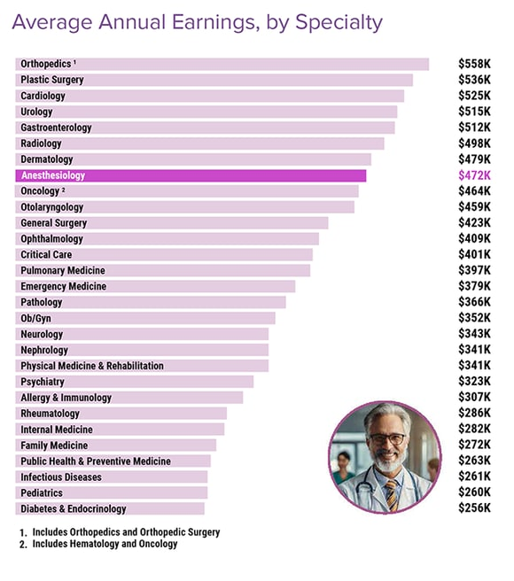
Medscape Anesthesiologist Compensation Report 2024

Slide 20

The Omnibus Budget Reconciliation Act (OBRA) of 1986 established direct reimbursement for CRNAs under Medicare Part B, effective January 1, 1989. CRNAs are eligible for direct reimbursement regardless of whether they are supervised by physicians.

Slide 21
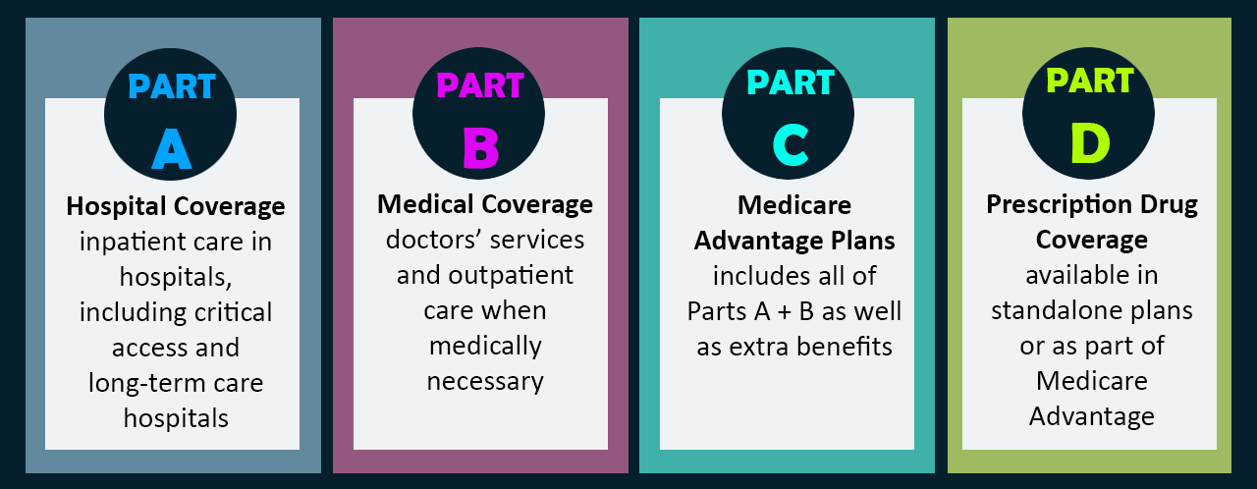
Medicare

Slide 22
Medicare Part A Supervision
Reimbursement for facility fee
In order to be in compliance (hospitals) with the Conditions of Participation (CoP) for (CMS Part A) CRNAs must be supervised by an anesthesiologist that is immediately available or the operating practitioner unless you are in one of the 25 opt out states
For ASCs the compliance document is the CMS Conditions for Coverage (CfC) which mandates that CRNAs must work under the supervision of the operating practitioner unless in an opt out state
State surveyors use Interpretive Guidelines to ascertain compliance with the CoPs/CfCs
There is no anesthesia payment associated with Medicare Part A (but you have to be in compliance to get reimbursed from Medicare Part B)

Slide 23
Medicare Part A Supervision and Opt-Out
State Supervision Opt-out
Governor sends letter to CMS stating it wants to opt-out (2001)
Opting-out consistent w/ State law
Consults w/ State Boards of Medicine & Nursing (in best interest of the citizens)
Opt-out effective once sent
As of now, 25 states, Washington D.C. and Guam have opted out of the (CMS) physician supervision requirement for CRNAs under Medicare Part A. This allows CRNAs to provide anesthesia services without physician supervision in those states.
It’s important to note that this opt-out status doesn’t change the CRNA scope of practice—it strictly affects facility reimbursement under Medicare Part A. The scope itself is governed by state laws and facility bylaws.

Slide 24
Medicare Part B
Reimbursement for Dr’s / anesthesia provider (CRNAs)
Since 1989 CRNAs in all states have been able to bill Medicare directly
No physician supervision is required
Payment performed by a CRNA may be made to the CRNA or they turn over their billing rights
Payment is through one of the following anesthesia payment models: medical direction (ACT), medical supervision or non-medically directed (CRNA only)
AAs must work under the direction of a physician anesthesiologist

Slide 25
Billing Anesthesia Modifiers
CRNA Modifiers
QX CRNA or AA service; with medical direction by a physician
QZ CRNA service; without medical direction by a physician
Anesthesiologist Modifiers
AA Anesthesia services performed personally by the anesthesiologist
AD Medical supervision by a physician; more than 4 concurrent anesthesia procedures
QK Medical direction of two, three or four concurrent anesthesia procedures involving qualified anesthetists
QY Medical direction of one qualified anesthetist by a physician
GC Services performed by a resident under the direction of a teaching physician

Slide 26
Medicare Practice Models
CRNA Only / Consultative Model (QZ)
Anesthesiologist Supervision (more than 4 concurrent cases) (AD)
Anesthesiologist Only (AA)
Anesthesiologist Medical Direction (1 or 2-4 concurrent cases) (QX, QY, QK)

Slide 27
Practice Model Reimbursement
CRNA only (QZ) (No medical direction) the CRNA receives 100% allowed and the anesthesiologist receives 0%
Anesthesiologist only (AA) the anesthesiologist receives 100% allowed and the CRNA 0%
Medical direction (QX,QY,QK) the CRNA and the anesthesiologist both receive 50% allowed
Payment at the medically supervised rate (AD) the anesthesiologist receives 3 units (+ 1 unit for induction) and the CRNA receives 50% allowed

Slide 28
Medical Direction Criteria
TEFRA (1982) – Tax Equity and Fiscal Responsibility Act
Maximum of 4 cases that an Anesthesiologist can medically direct and bill
In every case the Anesthesiologist must meet the 7 TEFRA requirements

Slide 29
7 TEFRA Requirements
Performs a pre-anesthetic examination and evaluation;
Prescribes the anesthesia plan;
Personally participates in the most demanding procedures in the anesthesia plan, including, if applicable, induction and emergence;
Ensures that any procedures in the anesthesia plan that he or she does not perform are performed by a qualified individual;
Monitors the course of anesthesia administration at frequent intervals;
Remains physically present and available for immediate diagnosis and treatment of emergencies; and
Provides indicated-post-anesthesia care.

Slide 30
The medical direction model (ACT) has nothing to do with quality or safety!!!
It is purely a payment model for billing under Medicare Part B
The QZ “CRNA ONLY” model is just as safe and more cost efficient by 25% than the next practice model according to the Lewin study (2010)
AAs cannot bill QZ, they must bill under medical direction

Slide 31
MEDICAL DIRECTION (ACT)
One anesthesiologist medically directs concurrent (2-4) CRNAs or AAs (4 is the max)
The MDA bills QK and receives 50% reimbursement
The CRNA bills QX and receives 50% reimbursement
If there are 4 cases, it will take 5 anesthesia providers
4 providers are generating money and 1 is not (up to 80 percent of all hospitals directly or indirectly subsidize their anesthesia services. )
Could be done with 4 CRNAs billing QZ and not medically directed

Slide 32
Reasons not to use Medical Direction
The anesthesia care team model is a failed model!
Creates 2 bills instead of 1
TEFRA rules must be met and if not, fraud is a possibility
Inefficiency in time utilization waiting for the anesthesiologist to show up for induction (Epstein article in Anesthesiology)
Creates subsidy by the hospital or ASC
In summary, it’s inefficient, costly, decreases productivity and does not increase the quality or safety of patient care

Slide 33
Supervision Model
Anesthesiologist supervision of more than 4 concurrent cases (CRNAs or AAs)
The anesthesiologist bills AD and gets 3 units/case and 1 more if present for induction
Any cases over 4 units and the anesthesiologist is not reimbursed
The CRNA is still able to bill QX and collect 50% of the case as in Medical Direction
The Problem: Money is left on the table!
Financially one of the worst models

Slide 34
Collaborative Model / Solo Model
Each provider does their own case and bills utilizing their own modifier (anesthesiologist=AA and CRNA=QZ)
Best possible system with least potential for fraud (breaking TEFRA rules)
No wasted anesthesia provider
Everyone is generating revenue

Slide 35
CRNAs – Hospital Employed
Anesthesiologist are employed by their group and medically direct 4 CRNAs (bill 4x50% or the MDA is getting 200%)
CRNAs are employed by the hospital and get 50% for the hospital
In some instances private insurance companies do not split the bill (QX/QK) so that the Anesthesiologist group get the entire amount, the hospital zero
The cost to the hospital becomes oppressive

Slide 36

Find the anesthesia practice model that meets the needs of the patients, facility and surgeons
The model should ensure safety and quality, maximize revenue, provider productivity and efficiency
The vision of All CRNAs should be to practice in a work environment that is Collaborative and bills all cases QZ and to function as a “Full-Service Provider”

Slide 37

Stephen D. Smith MA, CRNA, FAANA
Georgia Anesthesia LLC
404-429-8553 steve@georgiaanesthesiallc.com

Slide 38

References
1. www.aana.com - http://www.future-of-anesthesia-care-today.com/research.php
2. www.aana.com - https://www.aana.com/practice/practice-management/business-of-anesthesia
3. www.aana.com - https://sharepoint.aana.com/myaana/practicemanagement/Documents/Anesthesia%20Billing%20Basics%20Considerations%20Checklist.pdf
4. How Is Your CRNA Arrangement Affecting Your Reimbursement? http://www.pyapc.com/how-is-your-crna-arrangement-affecting-your-reimbursement/
5. http://monitor.pubs.asahq.org/article.aspx?articleid=2654730
6. https://www.aana.com/docs/default-source/bookstore-my-aana-web-documents-(members-only)/compensation-and-benefit-guide-2018---member-summary.pdf?sfvrsn=ea6b47b1_
7. https://pubs.asahq.org/monitor/article/84/10/1/110713/ASA-Survey-Results-Commercial-Fees-Paid-for
8. https://pubs.asahq.org/anesthesiology/article/116/3/683/13019/Influence-of-Supervision-Ratios-by
9. https://www.medscape.com/slideshow/2021-compensation-anesthesiologist-6013842#1
10. file:///C:/Users/user/OneDrive/Desktop/Compensation-and-Benefits-2021.pdf
11. https://www.beckershospitalreview.com/hospital-transactions-and-valuation/hospital-subsidy-support-for-exclusive-anesthesia-group-practices-expected-to-rise.html

Slide 39


