Slide 1

Business of Anesthesia and Related Topics
Copyright 2025
Stephen D. Smith MA, CRNA, FAANA
All Rights Reserved

Slide 2

Learner Outcomes
Discuss the laws that govern CRNA practice in your state
Summarize the outcome studies between CRNAs and Anesthesiologists
Explain when a surgeon is liable for a CRNA’s acts
Discuss the cost effectiveness of nurse anesthesia practice
Discuss the company model and the potential penalties for federal AKS violations
List the obstacles for independent CRNA practice
Describe the differences between CRNAs and AAs

Slide 3
Laws Governing CRNA Practice in Georgia
Georgia Registered Professional Nurse Practice Act
Medical Practice Act
Dental Practice Act
Georgia Podiatry Practice Act

Slide 4
You Must Know Your State Laws!
Nurse Practice Act – Anesthesia may be administered under the direction and responsibility of a duly licensed physician (MD or DO).
Medical Practice Act – This has to do with protocol language, one for prescriptive authority and one that does not contain this language.
Dental Practice Act – CRNAs can give IV sedation if the dentist has an IV conscious sedation permit and general anesthesia if they have a general anesthesia permit which requires 1 year’s training in anesthesia, or they are an oral surgeon.
Podiatry Act – We can give IV sedation but not general anesthesia. It’s a bit ambiguous but we practice in the capacity of an RN.

Slide 5
Georgia Registered Professional Nurse Practice Act
OCGA 43-26-3 Definitions – “Advanced nursing practice” includes nurse midwives, nurse practitioners, CRNAs, and clinical nurse specialists in psychiatric/mental health. “Advanced practice registered nurse” (APRNs) hold a master’s degree or other graduate degree from an approved nursing education program and national board certification in his or her area of specialty.
OCGA 43-26-11.1 – Anesthesia may be administered by a CRNA provided that such anesthesia is administered under the direction and responsibility of a duly licensed physician (MD or DO). The CRNA must practice in accordance with Board-approved AANAs current Guidelines and Standards for Nurse Anesthesia Practice.
So according to Georgia state law, there is no requirement that the physician provide direct or onsite direction.
With Medicare part A (cop and cfc) it does require direct supervision of an anesthesiologist or the operating practitioner unless you are an opt out state, which Georgia is not. To date, 25 states and Guam have opted out of the federal physician supervision requirement.

Slide 6

Medical Practice Act
OCGA 43-34-23 – There are two sections of the Medical Practice Act that apply to APRNs – both relate to protocols. The first is OCGA 43-34-23 which applies to all APRNs, including CRNAs. CRNAs utilize this provision. This section does not have any guidelines or requirements spelled out regarding the protocol.
We must protect this act. It is critical to our practice.
OCGA 43-34-25 – This applies to all APRNs other than CRNAs and is the prescriptive authority law which CRNAs were specifically and voluntarily excluded from. Why? This protocol must be signed by a delegating physician who is in a comparable specialty as the APRN.

Slide 7
Dental Practice Act
OCGA 43-11-21 – Can only provide sedation for a dentist who is duly permitted. (IV Conscious Sedation Permit)
OCGA 43-11-21.1 – Can only provide general anesthesia for a dentist who completed a minimum of one year of advanced training in anesthesiology or is a Board Certified Oral and Maxillofacial Surgeon.

Slide 8
Georgia Podiatry Practice Act
General anesthesia can only be administered under the direction of a duly licensed physician. A Podiatrist is not an MD or DO.
We can provide sedation for them in our capacity as a RN not CRNA.
It’s a bit ambiguous, in that, we provide anesthesia as an RN and bill as a CRNA.

Slide 9
Quality of Care in Anesthesia
Numerous outcome studies have demonstrated that there is no difference in the quality of care provided by CRNAs and MDAs
Needleman/Minnick OB Anesthesia Study – 2008 OB anesthesia is equally safe in hospitals that use CRNAs or MDAs or the combination
Simonson OB Study – 2007 (Anesthetic Complications during C/S) No difference in complication rates or mortality rates between hospitals that use only CRNAs with hospitals that use only MDAs
“Pine Versus Silber Study” – 2000 The Silber study contained glaring methodological deficiencies that Pine endeavored to avoid. Pine confirmed no difference in mortality rates when anesthesia is given by a CRNA or MDA working solo or in combination. CMS refuted and dismantled the Silber Study. The article suggested that CRNAs need medical direction by physician anesthesiologists but did not compare anesthesiologists versus CRNAs. The ASA tried to use the article for purely political reasons and sadly they are still trying.

Slide 10
NURSING ECONOMIC$
Conducted by the Lewin Group and published in May/June 2010 “Cost Effectiveness Analysis of Anesthesia Providers”
Study shows CRNA-Only anesthesia delivery most cost effective at least by 25%
Study shows no difference in quality or safety by anesthesia provider of delivery model

Slide 11
HEALTH AFFAIRS
Conducted by RTI International and published in August 2010 “No Harm Found When Nurse Anesthetists Work Without Supervision by Physicians”
Examined nearly 500,000 individual cases
The RTI findings demonstrate that the Medicare physician supervision rule for CRNAs is obsolete and unnecessary
Recommend that CMS repeal the supervision rule

Slide 12
Institute of Medicine Future of Nursing Report
The 2010 IOM report urges policymakers to remove policy barriers that hinder nurses, particularly CRNAs / APRNs from practicing to the fullest extent of their education and training ensuring all Americans access to safe, affordable healthcare.

Slide 13

THE COCHRANE LIBRARY
This literature (2014) review determined that no definitive statement can be made about the possible superiority of one type of anesthesia care over another.

Slide 14

MEDICAL CARE
Official Journal of the Medical Care Section, American Public Health Association
Scope of Practice Laws and Anesthesia Complications: The research results suggest that there is virtually no evidence that complication rates differ based on anesthesia provider scope of practice or anesthesia delivery model. (2016)

Slide 15

Surgeon Liability
Courts examine the degree of “control” the physician exercises over the anesthesia provider, regardless of whether the provider is a CRNA or MDA.
A physician is not automatically liable when working with a CRNA; nor is the physician immune from liability when working with an MDA.
It is clear from the case law that for a physician to be liable for the acts of the anesthesia administrator, the physician must “control” the administrator's actions and not merely be supervising or directing the administrator.
It is false for anyone to state or imply that surgeons are at greater risk when they work with nurse anesthetists rather than anesthesiologists.

Slide 16
Cost Effectiveness of Nurse Anesthetist Practice
CRNA – takes 8 years to prepare
MDA – takes minimum of 12 years to prepare
Costs of the entire education pathway according to the Lewin group is 15% that of anesthesiologists
Therefore, about 6 CRNAs can be prepared for the cost of preparing a single MDA
In addition, those 6 CRNAs will have entered the work force and cumulatively provided anesthesia services for several years by the time the one MDA is ready to practice

Slide 17
Federal Anti-kickback Statute (AKS) Company Model
Referring physicians who typically also own the facility form a separate anesthesia company in order to share in anesthesia revenue
HHS-OIG issued an Advisory Opinion (No. 12-06) and (No. 13-15) on a “company model” arrangement and expressed that it could violate the Federal Anti-Kickback Statute (AKS)
The AKS prohibits receiving remuneration to induce referrals reimbursable by federal health programs. In some industries this is acceptable. However, in the Federal health care programs, paying for referrals is a crime.
The proposed arrangements involved “management services” and hiring the anesthesia group as an independent contractor paying a negotiated rate and retaining the balance of the anesthesia fees

Slide 18


Anti-Kickback Statute
AKS – Makes it a crime to give anything of value to a referral source in exchange for a referral or the purchase of certain item or services “remuneration for referral”
Examples of prohibited items include $$, trips, payment of seminar fees and expense relief – the payment of expenses such as equipment, drugs, supplies or services that are necessary for the operation of the referral service

Slide 19


Potential Penalties for Federal AKS Violations
Felony – Maximum fine $25,000 and/or imprisonment up to 5 years
Conviction means automatic exclusion from Federal health care programs
Civil Monetary Penalties: $50,000/violation + damages up to 3 times total remuneration
If you are providing any remuneration of any kind to a facility, directly or indirectly as payments for services or by providing drug, equipment or supplies, you are at risk! State laws apply!
Georgia state law O.C.G.A. 43-1B-4 (2010), as it applies, will not allow for any drugs, equipment or supplies to be furnished by you to the practice for allowing you to provide the anesthesia services

Slide 20

Obstacles in Independent CRNA Practice
Surgeon liability/scare tactics
State laws/scope of practice
Company Model

Slide 21
Comparison of CRNAs and AAs
History - In 1969 several MDAs created (AAs), Emory University in Georgia and Case Western Reserve University in Ohio. In 2000 the ASA increased advocacy efforts on behalf of AAs
CRNAs have been providing anesthesia for over 150 years
The anesthesiologist assistant (AA) is an allied health professional specializing in anesthesia who works solely under the direct supervision of a physician anesthesiologist (medical direction)
A CRNA is an APRN specializing in nurse anesthesia, trained and educated to deliver anesthesia care independently regardless of whether anesthesiologists are involved
There are 21 AA programs and AAs can practice in a total of 21 states, Guam and the District of Columbia
In contrast, there are currently approximately 150 NAPs (appx 15 pending) and CRNAs can practice in all 50 states.
According to the AAAA (American Academy of Anesthesiologist Assistants), there currently approximately 4100 working AAs.
There are more than 65,000 CRNAs/Residents, administering over 65 million anesthetics/year in the US

Slide 22
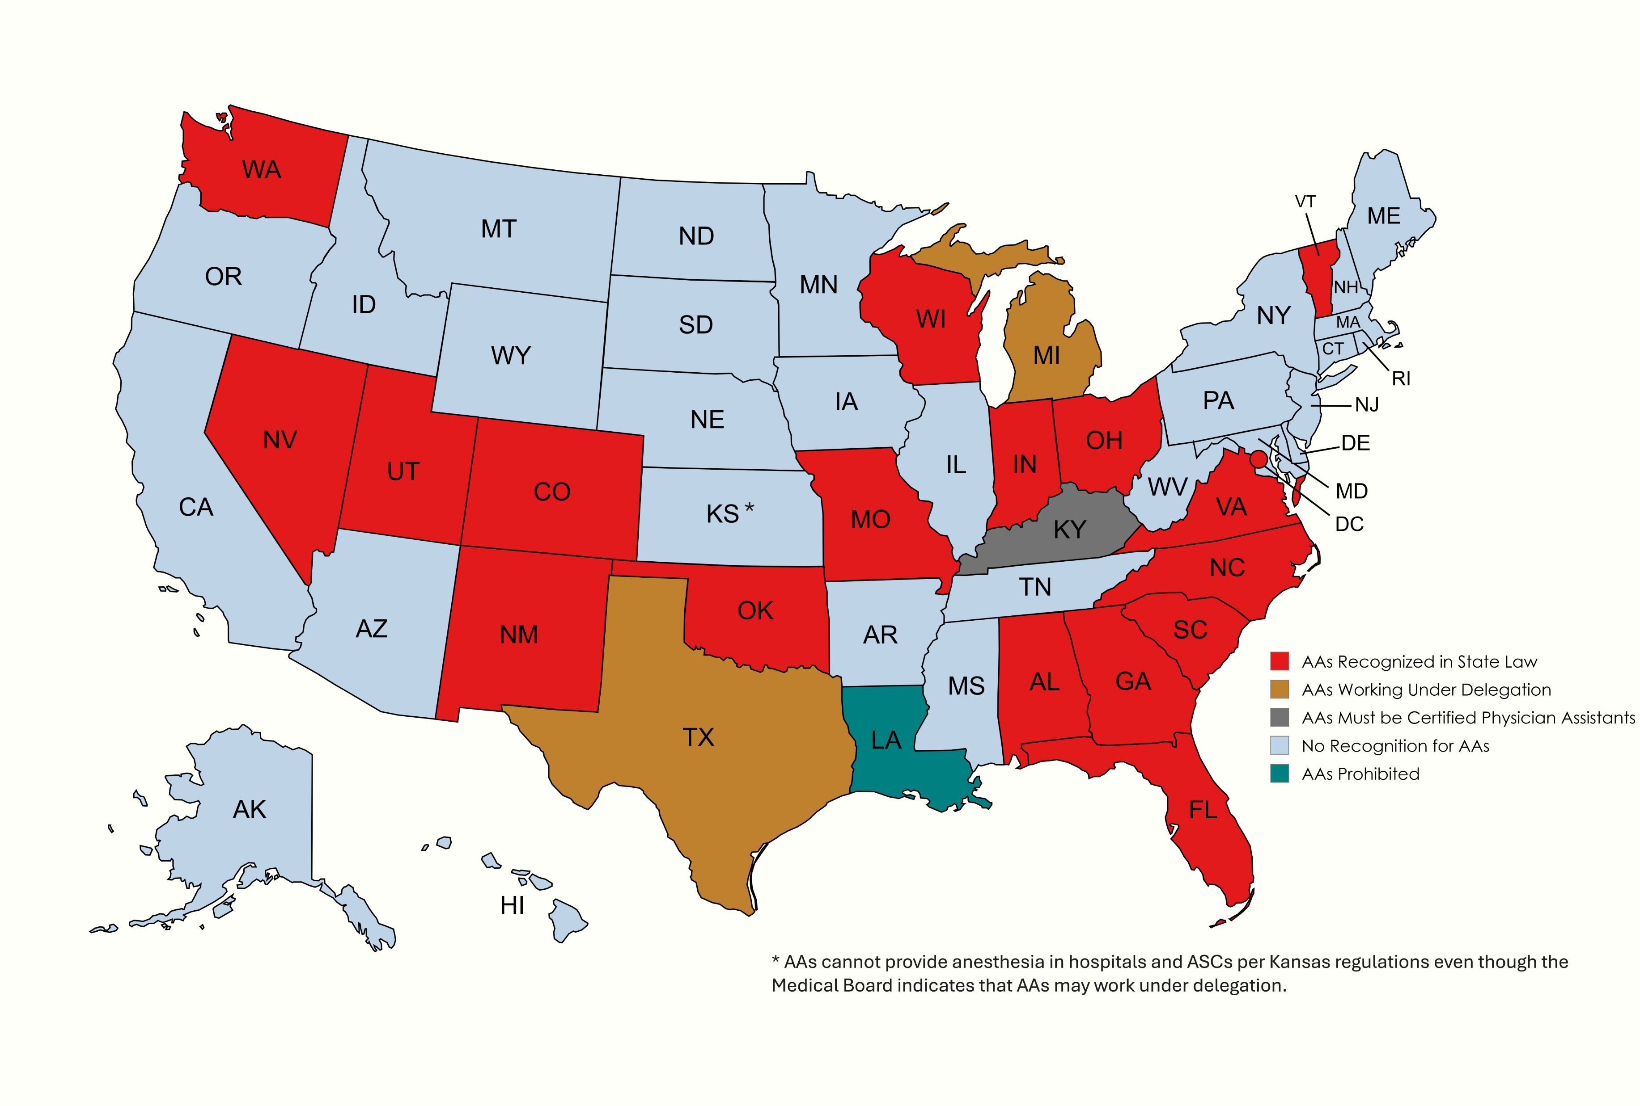

Slide 23
Comparison of CRNAs and AAs
CRNA annual graduation rate: potentially 3000 students for the first time this year
AA annual graduation rate: 350-400
CRNA program length 36-51 months (DNP/DNAP)
AA program length 24-28 months (Master’s)
CRNA admissions requirements: 4 years of nursing education; a baccalaureate; RN licensure; minimum 1 year of ICU experience (average = 2-5 years)
AA admissions requirements: Baccalaureate degree in the arts or sciences from an accredited institution. No healthcare education or certification required.
CRNA clinical education: During their education (nursing, ICU and anesthesia school), CRNAs will typically have acquired, on average, 12,593 (BSN,ICU,NAP) hours of clinical patient care experience.
AA clinical education: 2,000-2,700 hours during the AA program

Slide 24
Comparison of CRNAs and AAs
No peer-reviewed studies on the safety and quality of care of AA practice or AA anesthesia outcomes.
In contrast there are many landmark studies on the excellent, safe anesthesia care that CRNAs provide.
In May 2013, the CMS clarified and confirmed that AAs are prohibited from billing Medicare for non-medically directed services (billing code QZ). CRNAs can bill QZ.
Summary
CRNAs are better prepared and can work independently without an MDA and AAs cannot.
CRNAs are the most cost-effective billing QZ without medical direction.
AAs require medical direction therefore requiring 2 anesthesia providers increasing the costs of anesthesia.

Slide 25

References
https://sos.ga.gov/PLB/acrobat/Forms/38%20Reference%20-%20Nurse%20Practice%20Act.pdf
https://medicalboard.georgia.gov/sites/medicalboard.georgia.gov/files/related_files/site_page/Medical%20Practice%20Act%202013.pdf
https://gbd.georgia.gov/laws-policies-rules
https://sos.ga.gov/plb/acrobat/Laws/19_Podiatry_43-35.pdf
https://www.aana.com/search?keyword=surgeon%20liability
https://www.anesthesiallc.com/about-abc/102-communique/past-issues/winter-2019/1182-an-update-on-the-company-model-and-other-anesthesia-kickback-schemes
https://www.aana.com/docs/default-source/practice-aana-com-web-documents-(all)/professional-practice-manual/quality-of-care-in-anesthesia.pdf?sfvrsn=500049b1_2
https://www.anesthesiafacts.com/?fbclid=IwAR0eIVddgMmg4V0ylRM4fdy7vaXqqivDkF9agAcM3tqpOr22pIDUv6eAN3Q
https://www.aana.com/advocacy/state-government-affairs/sga-member-resources/anesthesiologist-assistants

Slide 26

Stephen D. Smith MA, CRNA, FAANA
Georgia Anesthesia LLC
404-429-8553 steve@georgiaanesthesiallc.com

Slide 27

Questions

