Slide 1
Trends, Growth, and Financials of Anesthesia as an Industry
Jason Trudell, DBA(c), MHA, MSN, CRNA

Slide 2
Conflict of Interest Disclosure Statement
Jason Trudell DBA(c), MHA, MSN, CRNA
I have the following relationships to disclose.
I am the CEO of Executive Anesthesia, Inc.
The views expressed in this presentation do not reflect official policy of Executive Anesthesia, Inc.

Slide 3
Lecture Content
Trends
Growth
Feasibility
Econometrics

Slide 4
Lecture Content
Healthcare
Payors
Politics
Policy
People

Slide 5
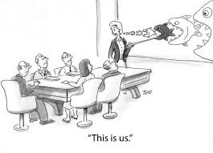
National Healthcare
Health Systems
Provider Delivery Groups
Anesthesia
One small cog in a big machine
WE DON’T HAVE TO LIKE IT BUT.. WE DO HAVE TO DO IT! – Basic Training DI, Ft. Knox, KY, June 2001
Notes:
From the macro (National Healthcare) to the micro (anesthesia)

Slide 6
Trends

Slide 7
Trends
Payors
increased shift in government payors
70% government consolidated payors
Consolidated payor market is down to five
Different Inflation Measures result in a divergence in HOPD vs. ASC’s vs. Inpatient Surgery
Notes:
CMS applies two different measures of inflation to update each payment system
HOPDs, CMS uses the hospital market basket, which measures the cost of medical expenses
ASC’s, CMS uses the Consumer Price Index – Urban (CPI-U) which measures the cost of goods such as milk and bread.
CPI-U is totally unrelated to medical costs and historically lower than the hospital market basket

Slide 8
Medicare Cost and Non-Interest Income by Source as a Percentage of GDP (http://www.ssa.gov/oact/trsum/)
(Short term) Recession has decreased the taxable income used to fund Federal and State based healthcare coverage programs
(Long term) Monetary easing policy devalues the dollar. E.g. the dollar doesn’t go as far
Rising care delivery costs outpace tax revenue. Est. 2026 (June 2013)
Notes:
The OASDI income rate—which includes payroll taxes, taxes on benefits, and any other transfers of revenues to the trust funds excepting interest payments—was 12.83 percent in 2012 and increases slowly over time, reaching 13.25 percent in 2087. The scheduled payroll tax rate remains unchanged from the current 12.4 percent level. Annual income from the other tax source, the taxation of OASDI benefits, will increase gradually relative to taxable payroll as a greater proportion of Social Security benefits is subject to taxation in future years, but will continue to be a relatively small component of program income.
The HI income rate—which includes payroll taxes and taxes on OASDI benefits, but excludes interest payments—rises gradually from 3.18 percent in 2012 to 4.30 percent in 2087 due to the Affordable Care Act’s increase in payroll tax rates for high earners beginning in 2013. Individual tax return filers with earnings above $200,000, and joint return filers with earnings above $250,000, will pay an additional 0.9 percent tax on earnings above these earnings thresholds. An increasing fraction of all earnings will be subject to the higher tax rate over time because the thresholds are not indexed.
As Medicare cost grows over time, general revenue and beneficiary premiums will play an increasing role in financing the program. Chart C shows scheduled cost and non-interest revenue sources under current law for HI and SMI combined as a percentage of GDP. Medicare cost rising to 6.5 percent of GDP by 2087.

Slide 9
Trends
* CMS Provider Data 2022
Notes:
Assumptions
Commercial insured growth secondary to employment?

Slide 10
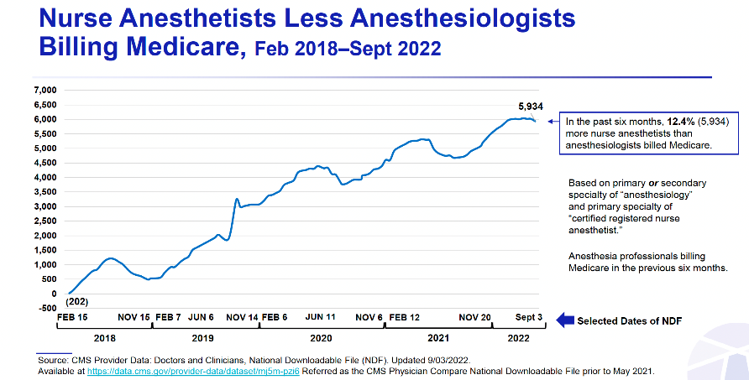
Trends
* CMS Provider Data 2022
Notes:
Assumptions
Commercial insured growth secondary to employment?

Slide 11
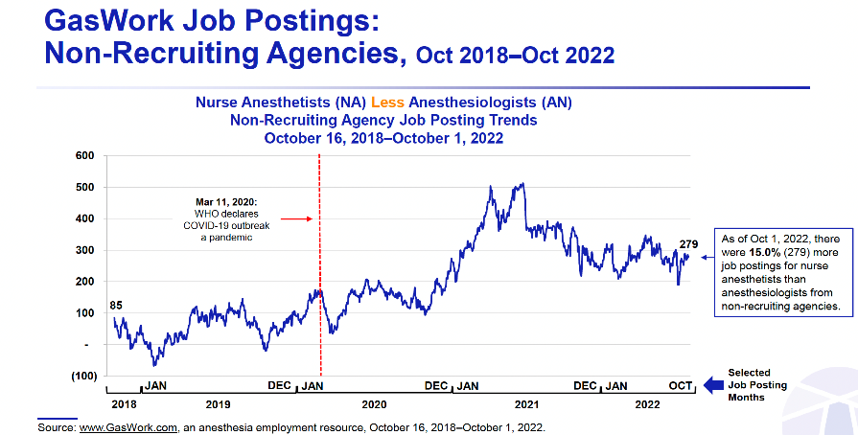
Trends
* CMS Provider Data 2022
Notes:
Assumptions
Commercial insured growth secondary to employment?

Slide 12
Trends
Patients
Consumerism will continue to expand
High deductible plans will continue to expand
Aging patient population will increase strain on narrowing tax base
Notes:
In 2003, Medicare procedures performed at ASC’s cost 83% fo the amount paid to hospital outpatient departments for the same services.
In 2016, Medicare procedures performed at ASC’s cost 53% of the amount paid to HOPD.

Slide 13
Trends
Procedures
Outpatient will grow relative to inpatient
Outpatient procedures will continue to expand
2005: 63% of all surgeries performed in the US did not require an overnight stay
2014: OIG found 68% of surgical procedures are considered to be low risk
Notes:
In 2003, Medicare procedures performed at ASC’s cost 83% fo the amount paid to hospital outpatient departments for the same services.
In 2016, Medicare procedures performed at ASC’s cost 53% of the amount paid to HOPD.

Slide 14
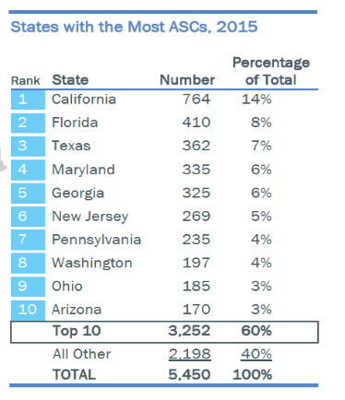
Trends
Placement
60% of all ASCs are located in 10 states
ASCs are getting larger: Since 2010, the number of ASCs with 1 or 2 Ors has decreased, and those with >3 ORs has increased
(2015) 5450 certified Medicare ASCs in the U.S.
(2022) 8469 certified Medicare ASCs in the U.S.
increase of 14% from 2010-2015
Increase of 35% from 2015-2022
2022 – 35 states maintain CON programs (vary greatly)
2022 - 12 states have fully repealed CON programs
Notes:
In 2003, Medicare procedures performed at ASC’s cost 83% fo the amount paid to hospital outpatient departments for the same services.
In 2016, Medicare procedures performed at ASC’s cost 53% of the amount paid to HOPD.

Slide 15
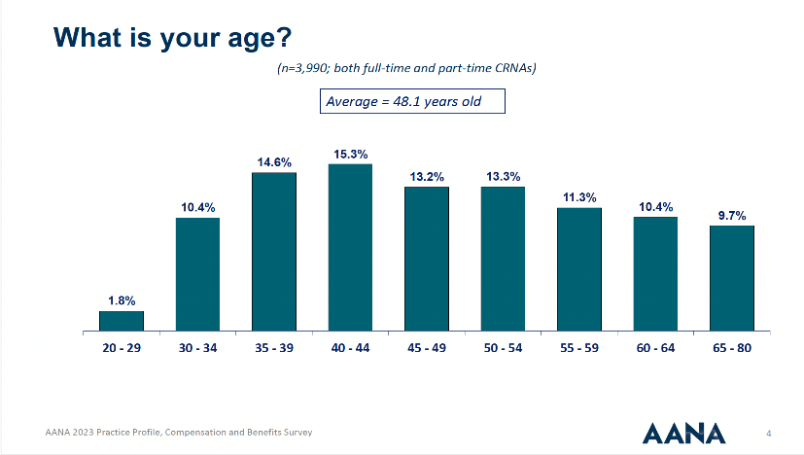
Trends
CRNA Workforce
Aging workforce reflective of US population

Slide 16
Trends
Anesthesia Workforce
Licensed clinicians but not working clinically

Slide 17
Trends
National Anesthesia Workforce
CRNA and Physician

Slide 18
Trends
National Anesthesia Workforce
AA’s

Slide 19
Trends
National Anesthesia Workforce
AA’s

Slide 20
Trends
CRNA Workforce
Within 5-10 years 22-33% of the CRNA workforce is projected to retire
Certain states will be effected more then others

Slide 22
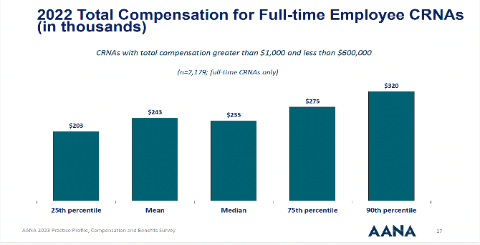
Trends
CRNA Compensation
Significant increase in CRNA compensation in the last 3 years
Stagnant from 2008-2014 (recession)
* AANA Annual Report 2023

Slide 23
Trends
Anesthesiologist Compensation
Significant increase in Anesthesiologist compensation in the last 5 years
Parallel growth to that of CRNA Compensation
* CMS Provider Data 2022

Slide 24
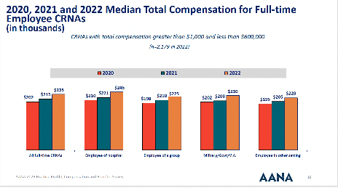
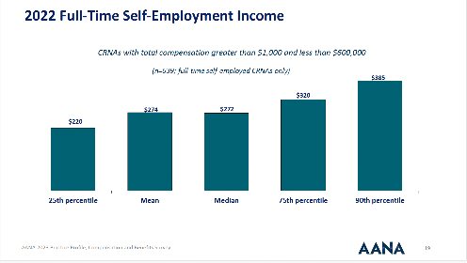
Trends
IC (1099) CRNA
Significant increase in the last 3 years (30+% nationally)
W2 (employed) CRNA
Overall national increase in total compensation package but typically lags behind IC comp rates
* AANA Annual Report 2013

Slide 28
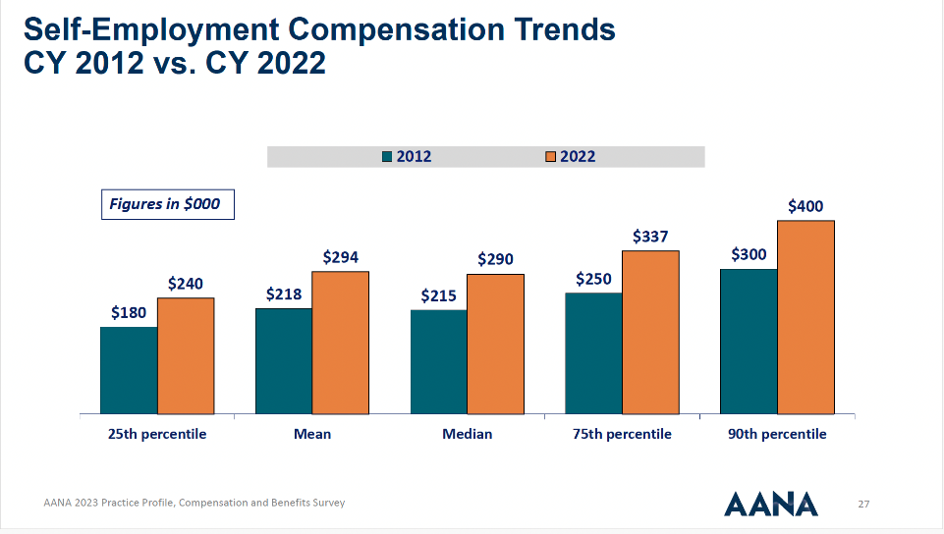

Slide 30
Growth

Slide 31
Growth
Politics
Great unknown!
Givens
Value agenda will continue to grow
Administration will continue push to drive down healthcare costs.
Push to create jobs and promote policy of intrinsic economic growth
Unlikely to repeal merit incentivized payment structure. Commercial and government payors don’t want an unchecked system.
Notes:
Assumptions
Commercial insured growth secondary to employment?

Slide 32
Growth
Payors
CMS will continue to experience funding shortfalls as tax base continues to narrow and retirees grow
Recession has equated to more government insured
Healthcare exchanges and ACA tax penalties end result TBD?
High deductible plans will continue to exist and likely expand.
Pre-existing conditions as grounds for cancellation are unlikely
ANB is a must and narrow provider networks will likely expand
NO SURPRISE ACT and IDR process will grow in complexity and cost
Notes:
Assumptions
Commercial insured growth secondary to employment?

Slide 33
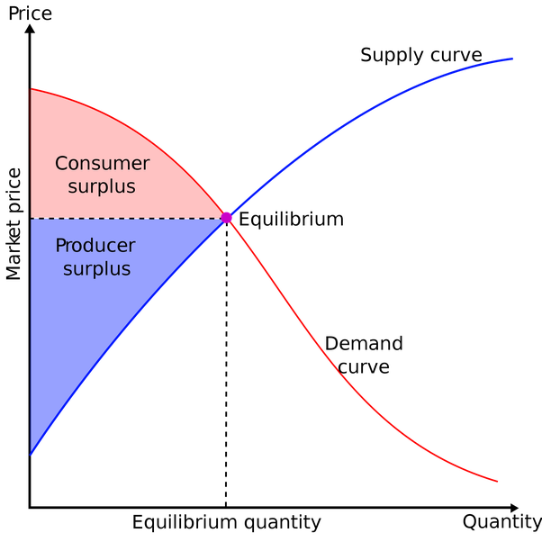
Growth
Clinician Supply vs. Service Demand
Notes:
Assumptions
Commercial insured growth secondary to employment?

Slide 34
Growth
Clinicians = Reduction in Supply
Stagnation or overall Decrease in the number of CRNAs and Anesthesiologists relative to per capita surgical growth
GME (graduate medical education) funding has been decreased in the last 4 budgetary cycles thereby decreasing the amount of funding available for resident training
CRNA education requirements have increased (transition to DNP)
Increased cost of education by ~30%
Increased time commitment (36 months vs. 28 on average)
Notes:
Assumptions
Commercial insured growth secondary to employment?

Slide 35
Growth
Clinicians cont.
Increase testing requirements (NBCRNA) transitioning to longitudinal assessment
Risk/Benefit of other ARNP fields
Nurse Practitioner demand up 70%
Resultant salaries up 30% in last 5 years
Shorter time frame to completion
1/5th the number of clinical hour requirements (mean: 600 vs. 3000)
Notes:
Assumptions
Commercial insured growth secondary to employment?

Slide 36
Financials

Slide 37
Financials
Anesthesia by the numbers:
$38 Billion dollar a year industry
22-27% of total anesthesia market is controlled by large PPAMCs
65% of all anesthesia practices are located in MSAs less then 250,000 people with hospitals typically less then 150 beds
Hospital and ASC subsidization is increasing

Slide 38
Employee Compensation
BENEFITS
Legally Required
Paid Leave
Supplemental Pay
Insurance
Retirement & Savings
Social Security
Federal Unemployment
Vacation/Holiday/ Sick/PTO
Premium Pay/Shift Pay
Non Production Bonuses
Defined Benefits
Defined Contributions
Employee Total Compensation = Wages (or Salary)
+
The payment for health benefits is always viewed as if it’s the employee’s own money. This is regardless if contributions are made by the employer or the employee.
Notes:
The payment for health benefits is always viewed as if it’s the employee’s own money. This is regardless if contributions are made by the employer or the employee.

Slide 39
Financials
Health Systems
Put together with asset roll up (mergers/acquisitions)
Currently undergoing a transition phase from a “Holding company” to an “Operational company”
Strategic shift to trimming assets that aren’t useful to a sustainable cost model
Hospitals rationalize service lines based on need/cost structure, e.g. interventional cardiology at a regional site vs. all hospitals within system
Notes:
Turnkey: $400/ sq ft

Slide 40
Financials
Health Systems
High rates of capital used on depreciated curve compression.
60-70% of operational cost structure is personnel (Facility)
Significant double digit increase post Covid (10%+)
60% of revenue is derived from outpatient services
An overall depreciation in capital (liquid and reserves) relative to operational costs
Notes:
Turnkey: $400/ sq ft

Slide 41
Growth
21% of CRNAs plan to retire in the next 6 years
* AANA Annual Report 2023
Notes:
Assumptions
Commercial insured growth secondary to employment?

Slide 42
Financials
Health System Demands in the Future:
Cardiology
includes EP but not traditional cardiac surgery (OH)
Structural heart programs
Orthopedics
Total joint
Spine
Endocrinology*
Cancer Care
GI
*Non surgical*

Slide 43
Financials
Anesthesia
Increased demand for clinicians with reduced workforce
Increased compensation indicative of increased demand vs. decreasing supply
Heavy reliance on “locum staffing” to fill in staffing shortages
Increased work week hours to offset FTE shortages

Slide 44
Econometrics

Slide 45
Econometrics
Future Changes:
Unlikely to un-fund a cheaper alternative to inpatient surgery
Advances in technology, safety, and training allow over 60% of surgery to be done as an outpatient
Consumer Price Index – Urban (CPI-U) inflation update is historically lower than the hospital market basket for payment updating
Post-Covid aggressive attempts at price controls (wage and compensation)
Supply and Demand challenges relative to workforce and FTE demands

Slide 46
Econometrics
Future Changes:
Big Unknowns
Intersection of workforce constraints with increased service demand
Efficiency in service utilization
Expansion of AAs?
Recruitment vs. Retirement paradigm
More reliance on federally funded programs

