Slide 1
From Bump to Birth: Current Trends in OB Anesthesia
Shawn Collins, PhD, DNP, CRNA, FAANA

Slide 2
Two Objectives
Describe recent and cutting-edge trends in obstetric anesthesia
1.
2.
Examine old blocks being used in new ways for obstetric anesthesia

Slide 3
01
Maternal M&M

Slide 4
Maternal M & M
Preeclampsia
Lack of markers defining HTN cause
Cannot predict preterm labor
Plasma levels of proteins released from the placenta, and placental growth factor (PlGF) (a proangiogenic factor), are altered in women with preeclampsia
Most promising, thus far, is the SFlt1/PlGF ratio
Notes:
Preeclampsia continues to be one of the leading causes of significant maternal and neonatal morbidity and mortality

Slide 5
Maternal M & M
Preeclampsia
At <34 weeks of gestation, an sFlt1/PlGF ratio of ≥85 distinguished preeclampsia from other causes of hypertension in pregnancy such as gestational and chronic hypertension (P < 0.001).
PREDICTIVE OF ADVERSE OUTCOMES
sFlt1/PlGF ratio is inversely correlated to the duration of pregnancy
Notes:
ADVERSE OUTCOMES IT WAS PREDICTIVE OF INCLUDES PLACENTAL ABRUPTION, ELEVATED LIVER ENZYMES/LOW PLATELETES, AND SGA/ABNORMAL UMBILICAL ARTERY
At < 34 weeks’ gestation, especially, delivery occurred within 2 weeks after presentation in 86.0% of women with a ratio ≥85 compared with 15.8% of women with a ratio of <85 (P < 0.0001)

Slide 6
Maternal M & M
Treating Preeclampsia HTN

Slide 7
Maternal M & M
Treating Preeclampsia HTN

Slide 8
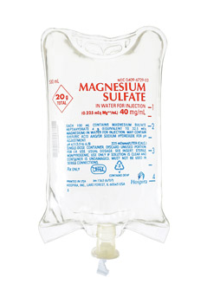
Maternal M & M
Anticonvulsant Prophylaxis/Management
Intravenous Magnesium Sulfate (20 g/500 mL bag)
4-6 g IV bolus in 100 mL over 20 min, followed by IV infusion of 1-2 g/hr. Continue for 24 hours postpartum.
Contraindicated in pulmonary edema, renal failure, myasthenia gravis
Magnesium Overdose Management
Intravenous Calcium Gluconate (1 g over 10 min)
For recurrent seizures or when magnesium sulfate is contraindicated
Lorazepam IV ( 2-4 mg IV X 1 , may repeat x 1 after 10 -15 min
Notes:
ADVERSE OUTCOMES IT WAS PREDICTIVE OF INCLUDES PLACENTAL ABRUPTION, ELEVATED LIVER ENZYMES/LOW PLATELETES, AND SGA/ABNORMAL UMBILICAL ARTERY
At < 34 weeks’ gestation, especially, delivery occurred within 2 weeks after presentation in 86.0% of women with a ratio ≥85 compared with 15.8% of women with a ratio of <85 (P < 0.0001)

Slide 9
Maternal M & M
Mothers with Congenital Heart Disease
Odds ratios (ORs) calculated for cardiovascular outcomes (arrhythmia, heart failure, cerebrovascular accident, embolism, death, or a combined outcome) versus non-CHD
Notes:
Women with CHD were more likely to suffer an adverse cardiovascular event (adjusted OR 8.4, 95% CI, 7.0–10.0). Arrhythmia was the most common adverse cardiovascular event, and heart failure (adjusted OR 7.0, 95% CI, 4.6–10.7), cerebrovascular accidents (adjusted OR 41.6, 95% CI, 25.8–67.1), and death (adjusted OR 6.7, 95% CI, 2.9–15.4) were more frequent in women with CHD.

Slide 10
Changing Demographics
Increasing obesity
Changes in obstetric practice
Patients with BMI ≥30 kg/m and the first stage of labor (from 4-cm cervical dilation)
Overdiagnosis of labor dystocia using traditional labor curve developed in 1950s
Notes:
In patients with BMI ≥30 kg/m the first stage of labor (from 4-cm cervical dilation) was significantly longer (4.7 vs 4.1 hours, P < 0.01), and this increase was predominantly due to slower cervical dilation between 4 and 6 cm (2.2 vs 1.9 hours, P < 0.01) compared with the <30 kg/m2 group.

Slide 11
02
Labor Management

Slide 12
Labor and Delivery
Risk for cesarean delivery is 12% to 20% higher in women carrying a male fetus
Male gender was associated with a significantly longer active first stage of labor (4.6 vs 4 hours, P = 0.002) than female gender.

Slide 13
Labor and Delivery
Management of labor
Electively induced in approximately 20% of pregnancies in the developed world
Elective induction of labor at 40 weeks’ gestation was associated with decreased odds of perinatal death (adjusted OR 0.44, 99% CI, 0.27–0.71, P < 0.001)
Notes:
The trend is even recognized starting at 37 weeks

Slide 14
Labor and Delivery
Management of labor
However, elective induction of labor was associated with increased odds of admission to the neonatal intensive care unit at all gestational ages <41 weeks (adjusted OR 1.15, 99% CI, 1.10–1.21, P < 0.001)

Slide 15
Labor and Delivery
Management of labor
Use of oxytocin for both induction and augmentation of labor was associated with increased odds for neonatal and maternal morbidity
Association between oxytocin therapy and neurodevelopmental disorders

Slide 16
03
Advances in OB Anesthesia

Slide 17
Spinal Anesthesia for C/S
Risk of hypotension
Significant correlation between high anxiety scores and maximal percentage change in systolic arterial pressure
Cardiac output was approximately 5% higher when patients were tilted ≥15º compared with <15º
My formula:
9 mg Bupivacaine
200 mcg Duramorph
10 mcg Fentanyl
Notes:
Most now treat with phenylephrine bolus versus ephedrine bolus, unless getting above T4
Some are injecting 50 mg of Ephedrine in quadriceps just after spinal placement
Platelet count of 70,000 x 10⁶/L or higher likely low risk of spinal epidural hematoma
Platelet count between 50,000 and 70,000 x 10⁶/L, weigh risks and benefits with parturient and obstetric professional based on parturient’s overall clinical condition

Slide 18
US Blocks
TAP Block
Fewer complications than neuraxial blockade
Avoids decreased urinary retention
Decreased systemic S/E
Increased analgesia and decreased systemic medication than multimodal approach

Slide 19
US Blocks
TAP Block
For lower abdominal wall or post surgical pain for surgeries below the umbilicus
Targets the subcostal (T12), ilioinguinal (L1), and iliohypogastric (L1) nerves
Needle placed between the two fascial layers of the internal oblique and transversus abdominus muscles
Will need to do Bilateral

Slide 20
US Blocks
TAP Block
Supine position
Use ultrasound
20 ml of local anesthetic per side
Complications: Violation of the peritoneum with or without bowel perforation
Notes:
Needle lengths range from 50 to 110 mm with a gauge of 18 to 22. Needle tips may be of the Tuohy, Sprotte (Teleflex), or facet types. The anesthesia provider can also elect to use a nonstimulating, echogenic needle to improve needle visualization during ultrasound imaging.
The addition of dexamethasone and/or epinephrine may prove beneficial to the TAP block. One study showed that adding dexamethasone (8 mg) to the local anesthetic agent prolonged the duration of the block and decreased the incidence of nausea and vomiting. Another study demonstrated that the addition of epinephrine 5 μg/mL
to the local anesthetic reduced the peak plasma concentration after unilateral TAP blocks, with no remarkable effects on block characteristics or duration.

Slide 21
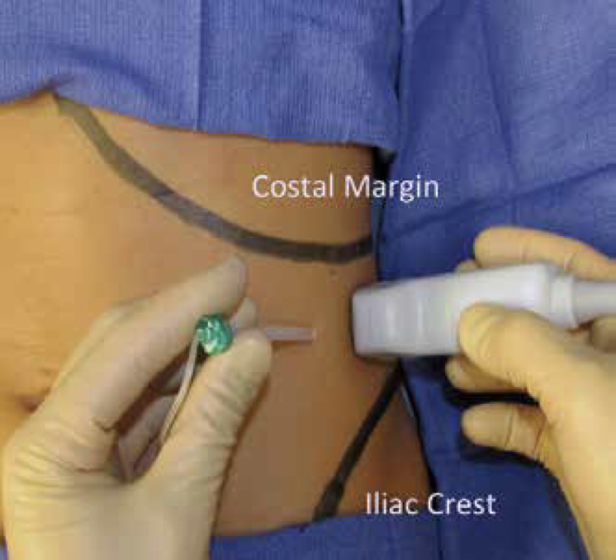
US Blocks
TAP Block
Positioning of the ultrasound transducer and needle for performing a mid-axillary TAP block
Notes:
Mid axillary line as this is where the probe is placed

Slide 22
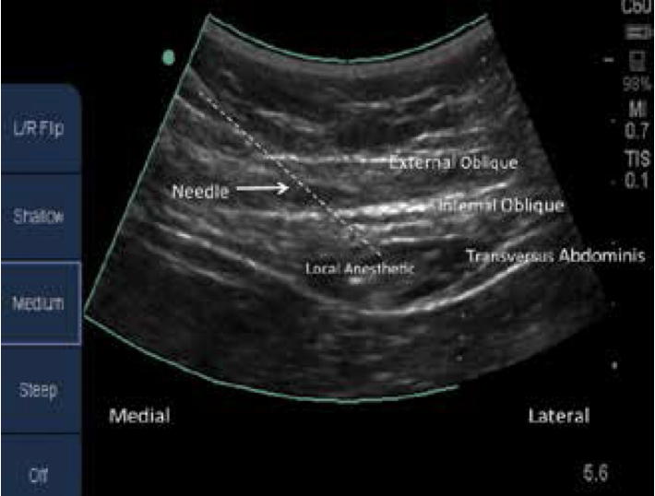
US Blocks
TAP Block
Ultrasound image of local anesthetic after it has been injected into the TAP with the mid-axillary approach.

Slide 23
US Blocks
Quadratus Lumborum Block
Done bilaterally into the thoracolumbar fascia
Different from TAP in that it blocks the posterior abdominal wall
Covers T7-L1
0.2% ropivacaine or 0.25% bupivacaine
3 possible approaches: Anterior, Posterior, Intramuscular
Notes:
Truncal block efficacy is dependent on proper spread of local anesthetic.
Fascial planes are compact resulting in greater spread and uptake of local anesthetic, increasing risk of LAST event.

Slide 24
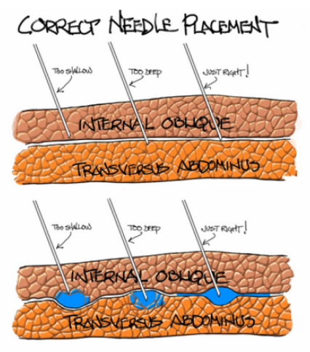
US Blocks
Quadratus Lumborum Block
Truncal block efficacy is dependent on proper spread of local anesthetic.
Fascial planes are compact resulting in greater spread and uptake of local anesthetic, increasing risk of LAST event.

Slide 25
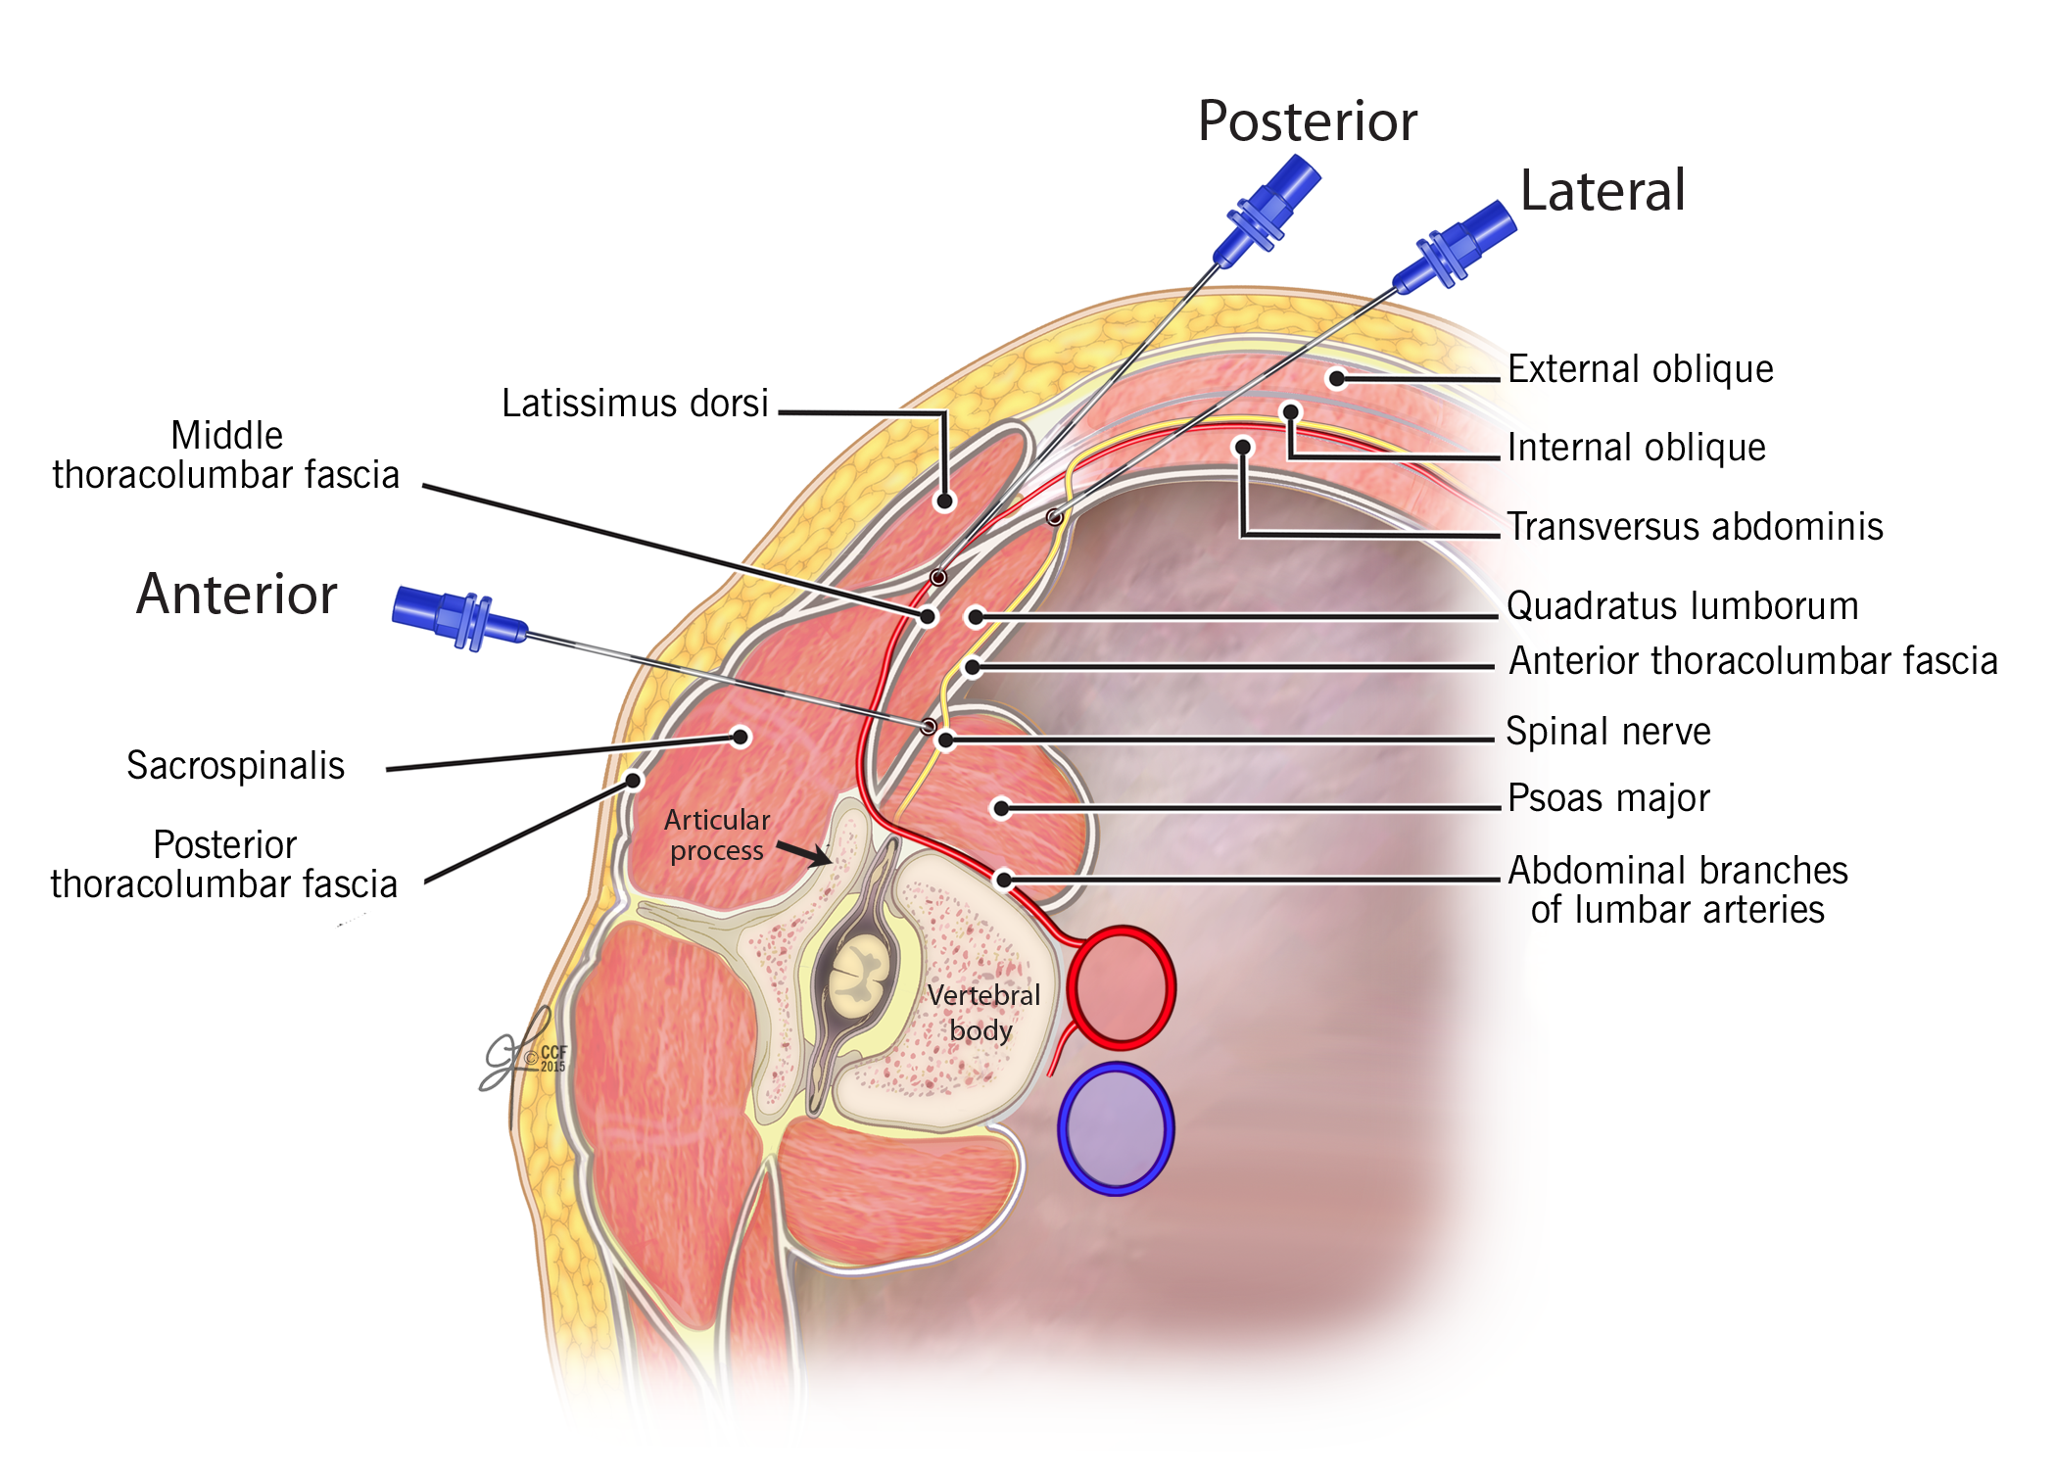
US Blocks
Quadratus Lumborum Block
3 possible approaches: Anterior, Posterior, Intramuscular (Lateral)

Slide 26
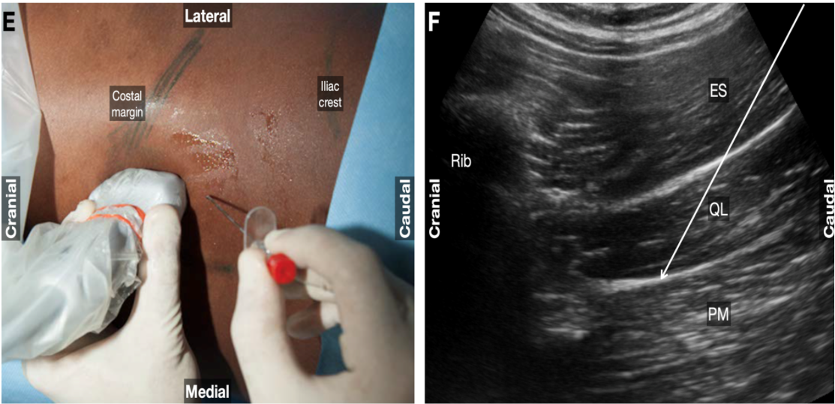
US Blocks
Quadratus Lumborum Block
Posterior approach
Notes:
ES, erector spinae; PM, psoas major; QL, quadratus lumborum.

Slide 27
Inhalation Analgesia
Nitrous Oxide
Rapid onset of pain relief (30-50 seconds)
Optional…not a substitute for neuraxial analgesia (40-60% will transition to neuraxial analgesia)
Self-administered via blender device
50% N₂0:50% O₂
Waste gas scavenger required
Monitor fetal response to maternal hypoxia

Slide 28
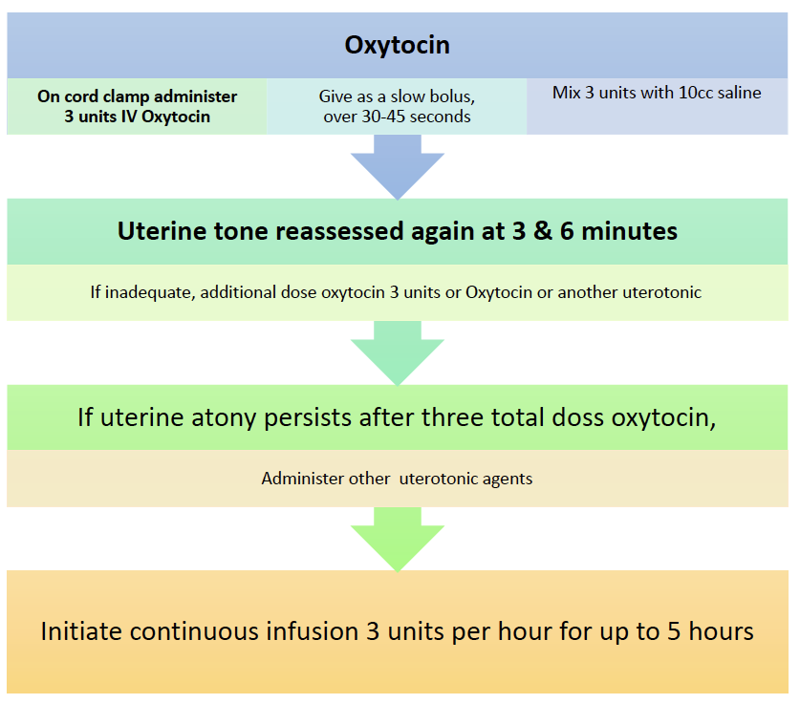
Rule of 3’s for Pitocin in C/S

Slide 29
Post-Cesarean Analgesia
Neuraxial Blockade
Neuraxial Opioids
IV Opioids
May prevent central sensitization and chronic pain development
Superior postoperative analgesia compared to IV opioids
When neuraxial opioids not provided or when breakthrough pain occurs with neuraxial technique

Slide 30
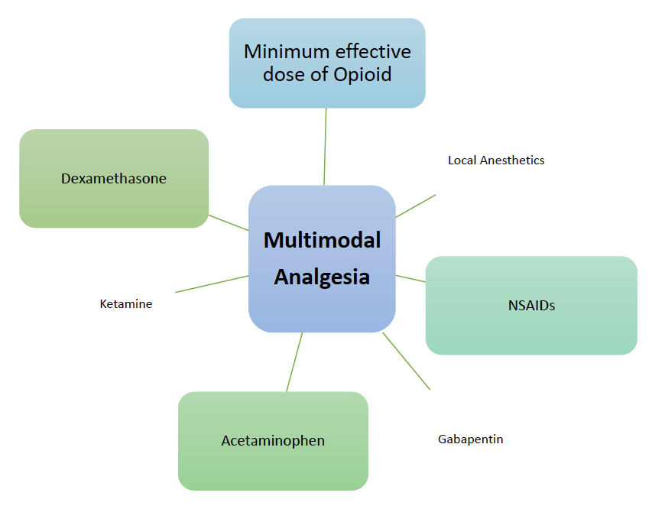
Multimodal Analgesia
Combination of several medications w/ different mechanisms of action
May produce additive or synergistic effects decreasing doses, side effects and transfer into breastmilk
May reduce opioid requirements

Slide 31
Neuraxial Opioid Dosing (PF)
Morphine
Fentanyl
Hydromorphone
0.5-0.15 mg intrathecal
1.0-3.0 mg epidural
14-36 hour duration
10-25 mcg intrathecal
50-100 mcg epidural
3-4 hour duration
Alternative for morphine
75-100 mcg intrathecal
6-24 hour duration

Slide 32
Post-Cesarean Analgesia
Central Acting
(10-20% opioid sparing effect)
Corticosteroid
NSAIDS
(10-20% opioid sparing effect)
Ketorolac
15-30 mg IV
Discontinue once oral can be taken
Ibuprofen
600-800 mg PO
Q 6-8 hours
IV Acetaminophen
1000 mg IV
Q 8 hours
Discontinue once oral can be taken
Oral Acetaminophen
650-1000 mg PO
Q 6-8 hours
Not > 3250 mg/day
Dexamethasone
8 mg (following umbilical cord clamp)

Slide 33
Additional Agents for Post C/S Analgesia
Gabapentin
600 mg oral
1 hour prior to surgery
Ketamine
10 mg or 0.15 mg/kg IV
Administer after neuraxial anesthesia and baby has been delivered
Local Anesthetic
Truncal block

Slide 34
04
Obstetric Complications

Slide 35
OB Complications
Hemorrhage
AFE
Defined as greater than 1000 ml
Rare but with up to 86% mortality.

Slide 36
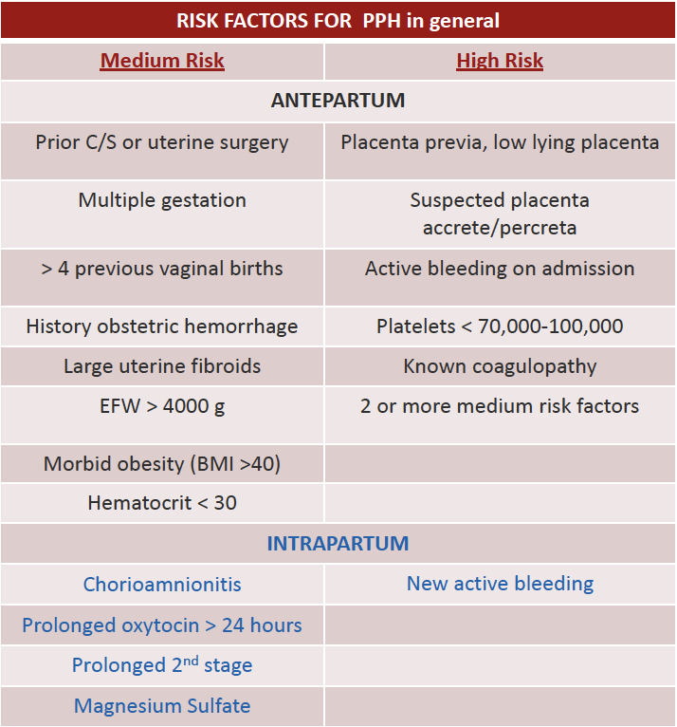
Postpartum Hemorrhage

Slide 37
Postpartum hemorrhage is related to one or more of four conditions:
01
03
02
04
Uterine atony
Genital tract trauma
Retained placenta
Coagulation abnormality

Slide 38
Postpartum hemorrhage ACOG Recs
https://www.acog.org/-/media/projectM/aecdoicgin/ea Qcouagloityr ga/nfdi lPeast/iefontr Smasfe/tdy iDstivriisciotns./ smi-ob-hemorrhage-bundle-hemorrhage-checklist.pdf

Slide 39
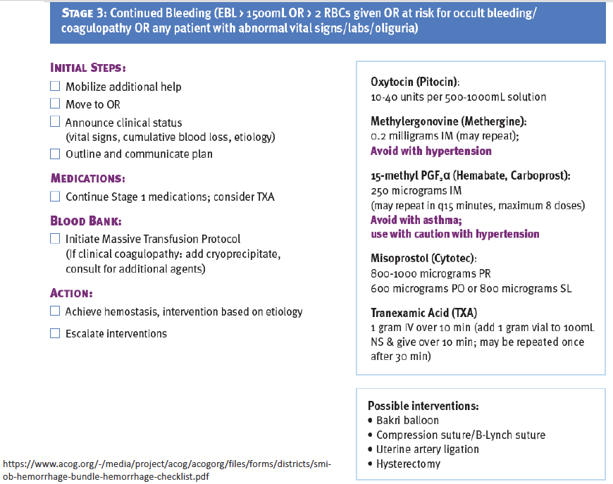
Postpartum hemorrhage ACOG Recs
https://www.acog.org/-/media/projectM/aecdoicgin/ea Qcouagloityr ga/nfdi lPeast/iefontr Smasfe/tdy iDstivriisciotns./ smi-ob-hemorrhage-bundle-hemorrhage-checklist.pdf

Slide 40
Postpartum hemorrhage ACOG Recs
https://www.acog.org/-/media/projectM/aecdoicgin/ea Qcouagloityr ga/nfdi lPeast/iefontr Smasfe/tdy iDstivriisciotns./ smi-ob-hemorrhage-bundle-hemorrhage-checklist.pdf

Slide 41
Amniotic Fluid Embolus
Rare: (1:20,000 deliveries) but potentially lethal complication
Can occur during labor, delivery, cesarean section, or postpartum (usually within 30 minutes).
Etiology: Entry of amniotic fluid into the maternal circulation through any break in the uteroplacental membranes.
Acute left ventricular dysfunction appears to be a common feature.
Typically, patients will present with sudden tachypnea, cyanosis, shock, and generalized bleeding (DIC).
Notes:
Mortality about 50% in the first hour
Trriggers Massive cascade of Inflammatory and hemostatic reactions

Slide 42
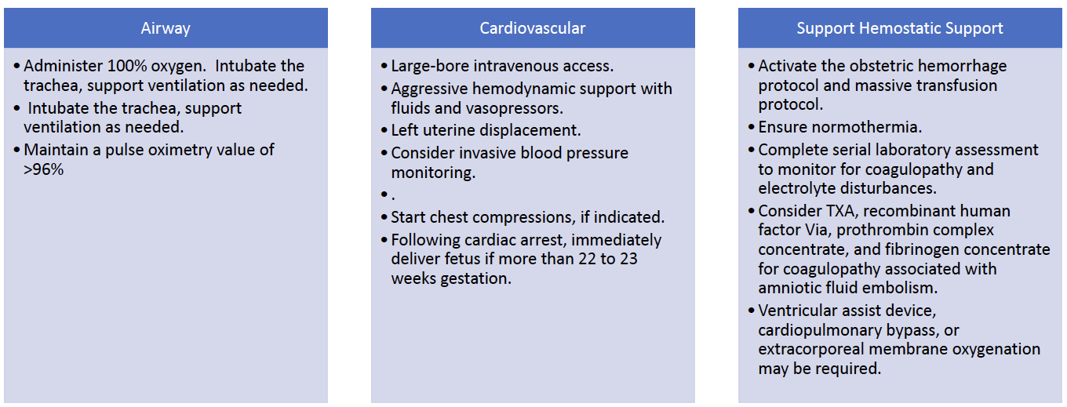
AFE Management
Notes:
Treatment: consists of aggressive cardiopulmonary resuscitation, stabilization, and supportive care. When cardiac arrest occurs prior to delivery of the fetus, the efficacy of closed-chest compressions appears to be marginal at best.

Slide 43
If you only suspect AFE…Consider A-OK

Slide 44
Questions?

