Slide 1
Surgical Pain Management for
Hot patients
Thomas Baribeault DNP CRNA
@BaribeaultOFA

Slide 2
1.
Terminology

Slide 3
HOT
Long term opioid therapy
Untreated Opioid Use Disorder
Medication assisted therapy
Fibromyalgia

Slide 4
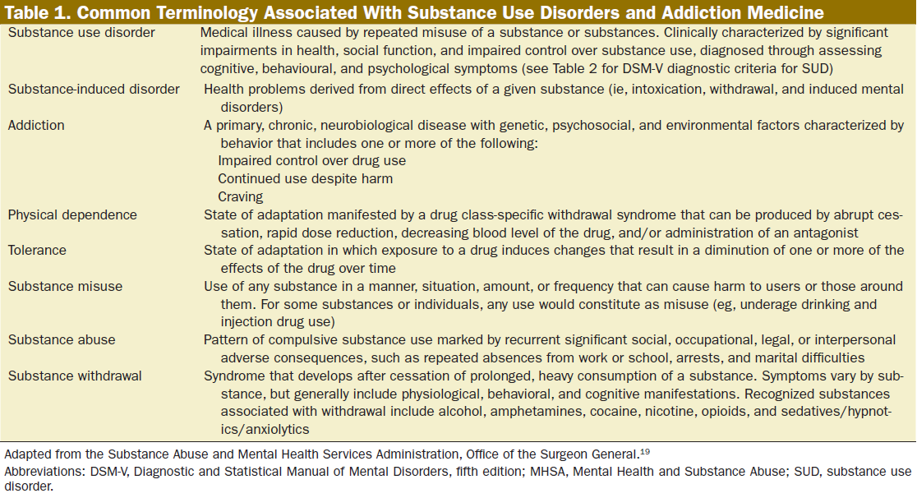

Slide 5
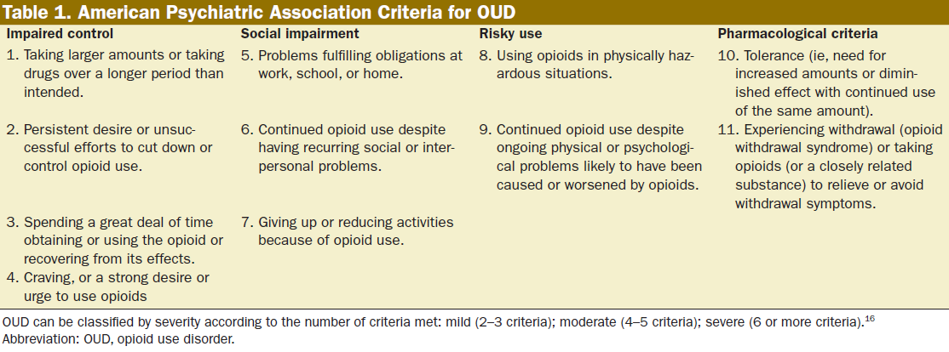

Slide 6
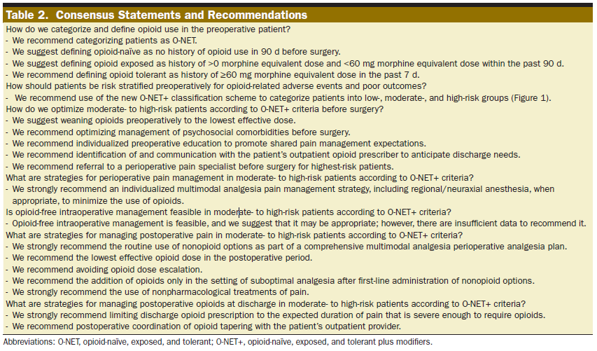

Slide 7
2.
Pre-operative Assessment

Slide 8
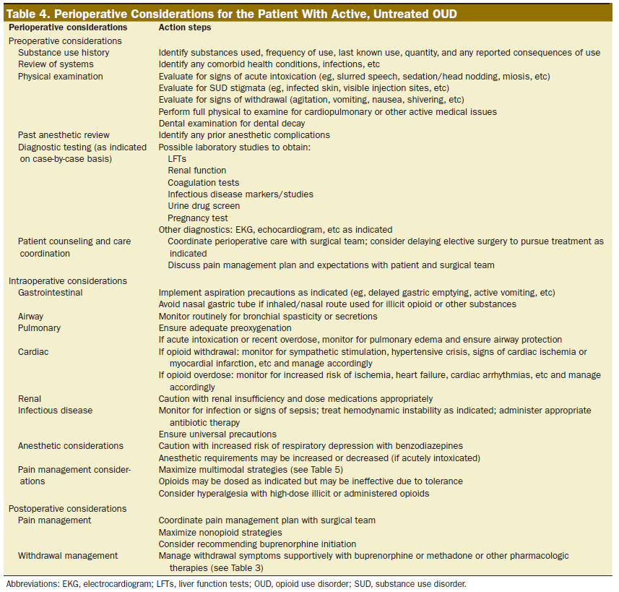

Slide 9
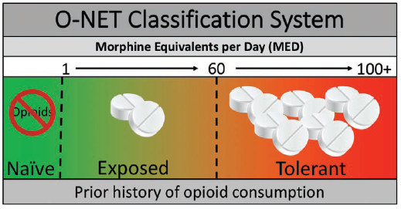

Slide 10
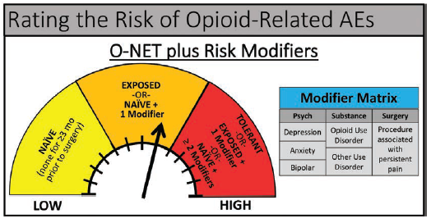

Slide 11
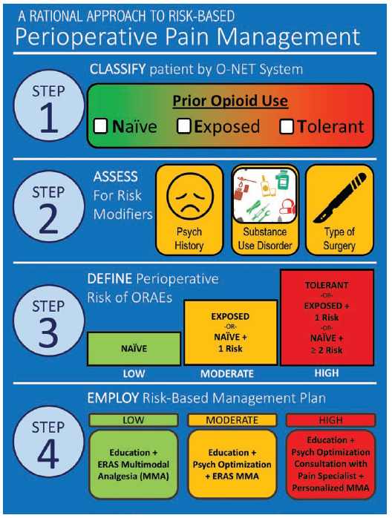

Slide 12
3.
MOUD

Slide 13
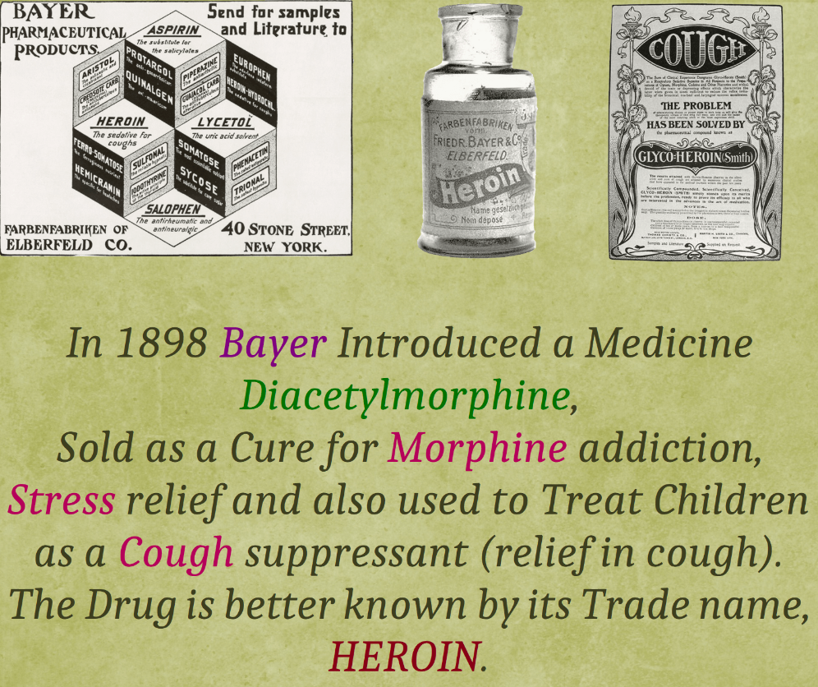

Slide 14
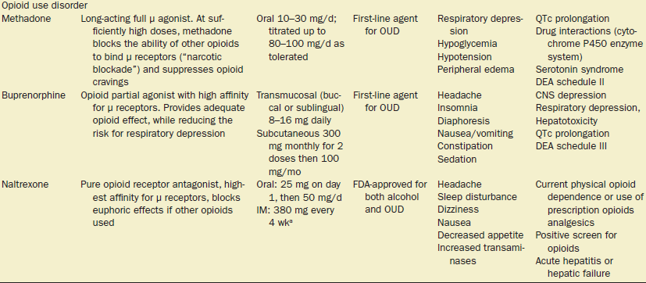

Slide 15
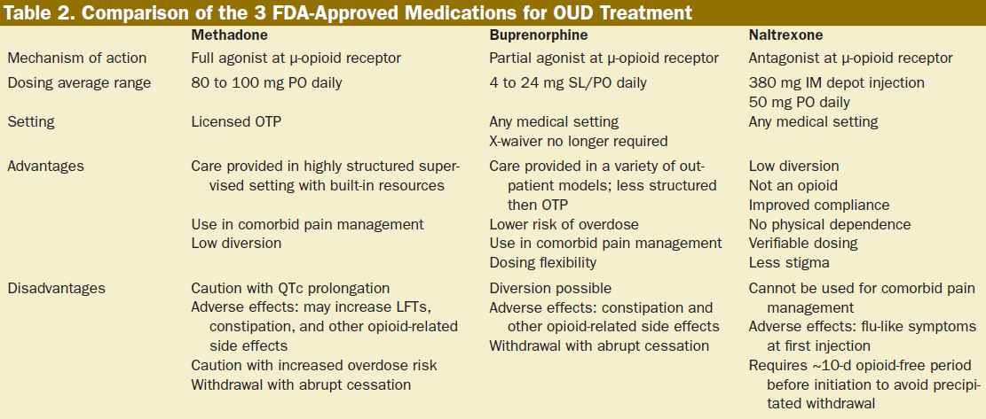

Slide 16
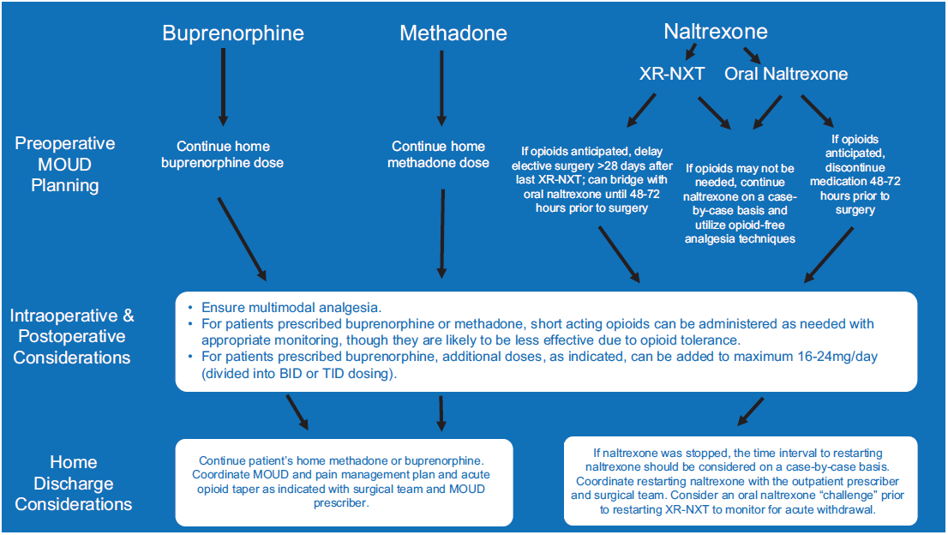

Slide 17
Considerations
Methadone
  OUD dosing is higher than pain dosing, do not increase outpatient dose
  May have Opioid Induced Hyperalgesia and Tolerance
  Especially sensitive to benzodiazepines
  Switch from PO to IV dosing
    ½ daily dose, divided Q6H
  Standard opioids PRN
  Use Narcan infusion for respiratory depression

Slide 18
Considerations
Buprenorphine
  Doses less than 16mg/day has fewer receptors occupied
  Can increase dose up to 24 mg/day for analgesia
  Split dose into BID or TID
  Sufentanil only opioid with higher affinity for opioid receptor
    Hydromorphone close second

Slide 19
Considerations
Naltrexone
  Opioid Free Anesthesia
  Aggressive regional anesthesia

Slide 20
4.
Fibromyalgia

Slide 21
Fibromyalgia
Multiple conditions
  Similar pathophysiology
Diagnosis
  Widespread pain index >7
  Symptom severity score >5
  >3 months
  Not explained by any other condition
Fibromyalgia-ness score
  Predictive of post-operative pain and opioids requirements

Slide 22
Fibromyalgia
Symptoms
  Magnified sensory transmission
    “volume knob concept”
    Pain, allodynia (tender points), heat & cold, auditory, and visual stimuli
  +/- inflammation
  Sleep disruption
  Memory problems
  Poor exercise tolerance
  Depression

Slide 23
Fibromyalgia
Treatment
  Aerobic exercise
  Cognitive behavioral therapy
Medical
  Anti-depressants
    TCA Amitriptyline
    SSRI/SSNI Duloxetine
  Gabapentinoid
    Gabapentin/Pregabalin

Slide 24
Fibromyalgia
Treatment
  Tizandine
  Tramadol/Tapentadol
Unsuccessful
  Opioids
    Overproduction of endogenous opioids

Slide 25
5.
Pharmacology

Slide 26
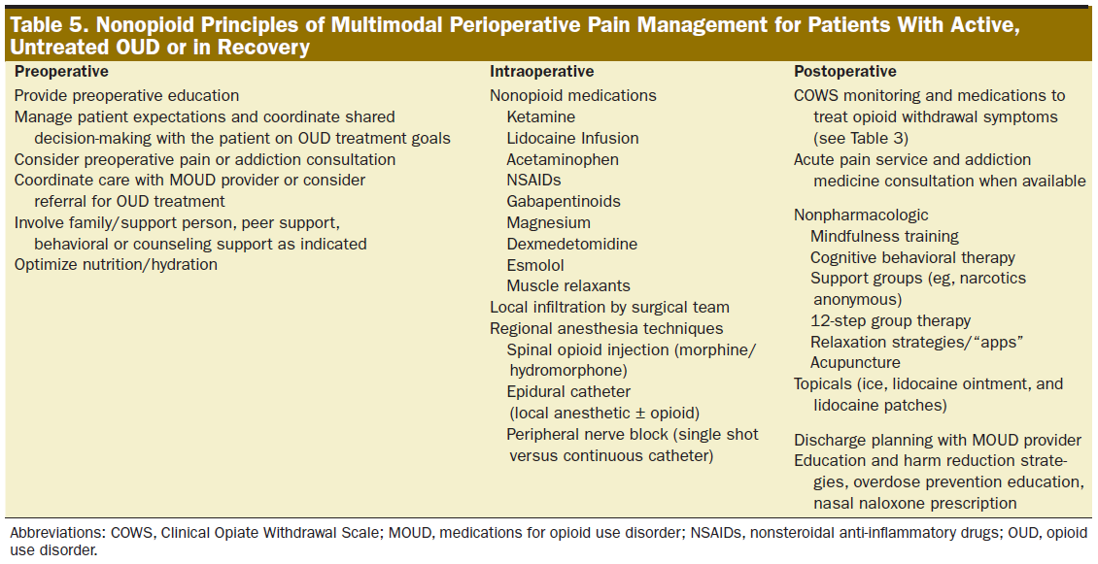

Slide 27
Ketamine
Dose
  0.1-0.3 mg/kg
  0.3-0.5 mg/kg
  0.1-0.5 mg/kg/hr = 2-10 mcg/kg/min
  1:1 morphine PCA
Mechanism
  Blocks NMDA receptor

Slide 28
Ketamine
Benefits
  Bronchodilator
  Treatment for depression, suicidal ideation, and PTSD
Considerations
  Caution cardiovascular disease, increased ICP, and catecholamine depression
  Hallucinations/disassociation
  Reverse and prevent OIH/OT

Slide 29
Lidocaine Infusion
Dose
  1-2 mg/kg
  2-3 mg/kg/hr
  1-2 mg/kg/hr
Mechanism
  Systemic analgesia 2, 8, 48 hours
  Blocks prostaglandin release
Considerations
  Safety
    2-3 mcg/ml plasma concentration

Slide 30
Acetaminophen
Dose
  1G Q6H
Mechanism
  Unknown
Considerations
  Liver dysfunction
  IV vs PO
  Endocannbinoid reuptake inhibitor

Slide 31
NSAID/Coxib
Cox 1 vs Cox 2 inhibition
  Cox 1
    Gastric ulcer
    Platelet dysfunction
    Renal dysfunction
  Cox 2
    Renal dysfunction
    Reduces pain, fever, and inflammation
Contraindications
  renal failure, gi bleed, thrombotic event, CABG, age >60, thrombocytopenia

Slide 32
NSAID/Coxib
Non-selective cox inhibitors
  Ketorolac PO, IV
  Meloxicam PO, IV
  Ibuprofen PO, IV, TD
  Diclofenac PO, IV, TD
  Naproxen PO
Cox 2 inhibitor
  Celecoxib PO
  Parecoxib IV (Non-US)

Slide 33
Gabapentin/Pregabalin
Dose
  Gabapentin 300-600 mg
  Pregabalin 75-150 mg
Mechanism
  Blocks release of glutamate
Benefits
  Reduction in chronic post-surgical pain
  Better reduction of neuropathic pain

Slide 34
Gabapentin/Pregabalin
Considerations
  Increases respiratory depression when used with opioids
  Post-operative sedation/dizziness
  Pregabalin fast absorption, more consistent plasma levels
  Pregabalin rare side effects
    Angioedema, thrombocytopenia, rhabdomyolysis, increased pr interval

Slide 35
Magnesium
Dose
  30-50 mg/kg
  10 mg/kg/hr infusion
Mechanism
  Prevents loss of Mg plug from NMDA receptor
Benefits
  Prevent post-operative shivering
  Reduces burn from Propofol
Considerations
  Caution in renal failure
  Prolongs NMB

Slide 36
Dexmedetomidine
Dose
  0.1-0.5 mcg/kg over 10 minutes
  0.2-1 mcg/kg/hr
Mechanism
  Sedation
    Blocks norepinephrine in the locus coeruleus
  Pain
    Blocks substance P from binding to the NK1 receptor

Slide 37
Dexmedetomidine
Benefits
  Reduced emergence delirium
  Anxiolysis
  Prevents post-operative shivering
Considerations
  Caution tachy/bradycardia, hyper/hypotension
  Post-operative sedation

Slide 38
Esmolol
Dose
  0.5-1 mg/kg
  5-500 mcg/kg/min
Mechanism
  Beta blocker
Benefits
  Analgesia vs preventing OIH/OT
Considerations
  Asthma

Slide 39
Tizanidine
Dose
  2-4 mg PO
Considerations
  Muscle relaxant with A2 agonist activity

Slide 40
Dexamethasone
Dose
  0.1-0.2 mg/kg
Mechanism
  Inhibits prostaglandins, leukotrienes, and histamine
Considerations
  Does not inhibit healing
  Raise blood sugar?

Slide 41
Serotonin/Norepinephrine
Tramadol/Tapentadol
  50-100 mg
  Opioid + SSRI
Duloxetine
  20-30 mg
  SSRI/SSNI

Slide 42
6.
References

Slide 43
references
American Society for Enhanced Recovery and Perioperative Quality Initiative Joint Consensus Statement on Perioperative Management of Patients on Preoperative Opioid Therapy
  DOI: 10.1213/ANE.0000000000004018
Caring for Our Patients With Opioid Use Disorder in the Perioperative Period: A Guide for the Anesthesiologist
  DOI: 10.1213/ANE.0000000000006280
Substance Use Disorders: Basic Overview for the Anesthesiologist
  DOI: 10.1213/ANE.0000000000006281
Fibromyalgia and Centralized Pain in the Rheumatoid Arthritis Patient
  DOI: 10.1097/BOR.0000000000000929

Slide 44
Questions?

