Slide 1


ANESTHESIA PROFESSIONAL LIABILITY:
RECENT LIABILITY TRENDS & RISK MANAGEMENT
Brian Thomas, JD – VP of Claims & Risk Management
Preferred Physicians Medical

Slide 2
Conflict of Interest Disclosure
Brian Thomas, JD is Vice President Claims & Risk Management for Preferred Physicians Medical, the nation’s only provider of medical professional liability insurance exclusively for anesthesia professionals and their practices. The speaker has no additional financial relationships with a commercial interest to disclose nor any undisclosed conflicts of interest.

Slide 3
OBJECTIVES
Have a better understanding of the most common types of claims and lawsuits involving anesthesia professionals.
Be able to evaluate potential areas of liability exposure in their own practice.
Learn strategies to advance patient safety and mitigate professional liability exposure.

Slide 4
OR Fire – Elements
Ignition Source
Electrocautery, Laser, Defibrillator
Fuel
Alcohol-Based Prep Solution, Drapes, Towels, Gauze, Sponges, Hair
Oxidizer
Supplemental O2 (especially from open sources like nasal cannulas masks), Nitrous Oxide
  Majority of cases involve head and neck procedures, supplemental O2, alcohol-based prep solutions, and electrocautery
  54 closed intraoperative fire cases – Indemnity = $5,558,282; LAE = $2,287,215

Slide 5
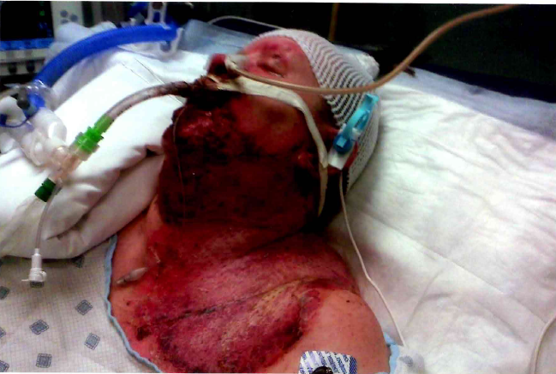
Case Study – OR Fire

Slide 6
OR Fire
Expert Criticisms
No fire risk assessment, time-out protocol, or other fire prevention plan
Alcohol-based prep solution not allowed to dry
No communication between surgeon and anesthesiologist before electrocautery use
O2 was not turned down or off before electrocautery use
No plan in place to manage OR fire

Slide 7
OR Fire – Prevention Strategies
Hospital/facility should have OR fire prevention protocol, including fire risk assessment and time out
Minimizing or avoiding an O2 enriched atmosphere near surgical site (consider ETT or LMA, turn down/off O2 before ignition source use, <30% FiO2)
Configure drapes to minimize accumulation of O2
Allow sufficient drying time for alcohol-based/flammable skin prep solutions
Moisten sponges and gauze when used in proximity to ignition sources
Active communication and timing between anesthesia professional and proceduralist is paramount
https://www.apsf.org/videos/or-fire-safety-video/

Slide 8
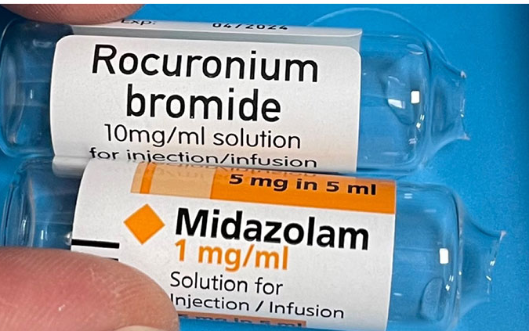
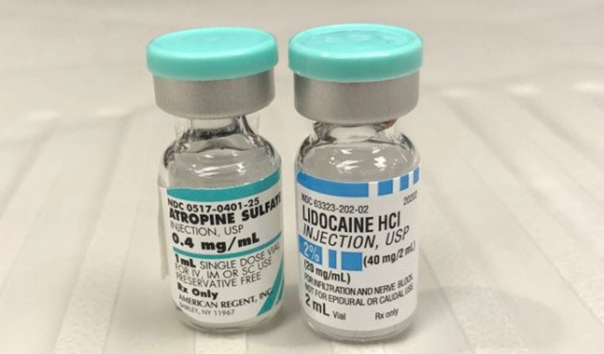
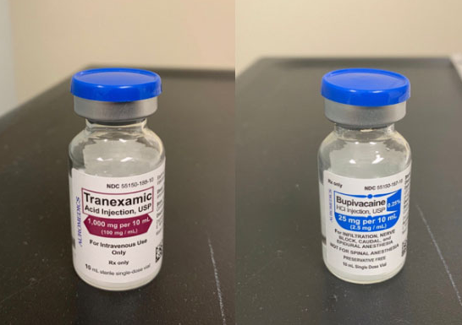
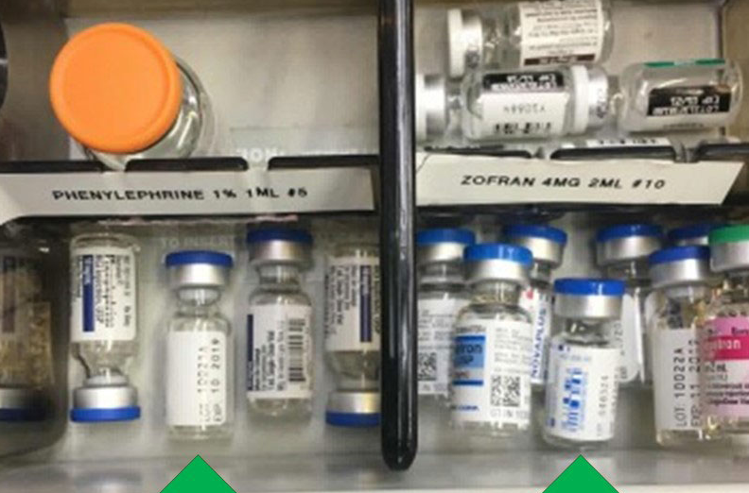
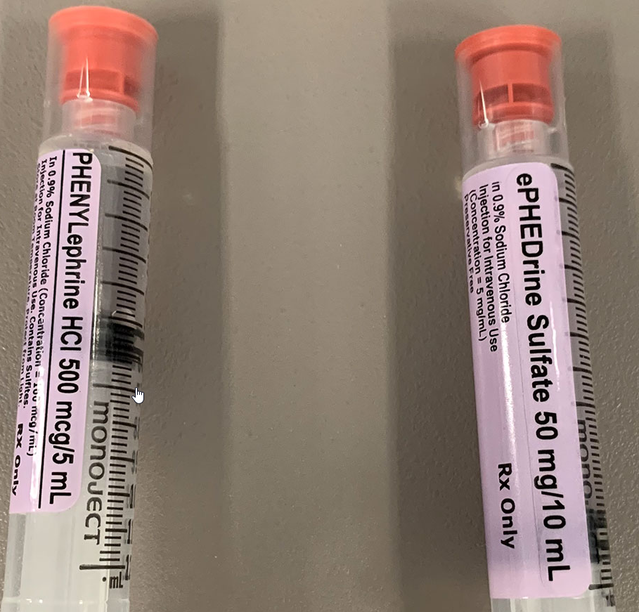
Medication Errors
Notes:
File #7364

Slide 9
Medication Errors – PPM Loss Data
Includes medication mix-ups, wrong dosage, overdose and allergic reactions
74 total claims (71 closed, 3 open)
Total indemnity paid on 71 closed claims = $17,249,724 ($242,954/claim)
Defense costs = $3,915,017 ($55,141/claim)
20 claims settled for >$100,000
4 tranexamic acid cases settled = $6,010,000
2 recent tranexamic acid mix-up incidents

Slide 10
Medication Errors: Tranexamic Acid - Case Study
59-year-old female presented for total (r) hip replacement performed under spinal anesthesia
Two CRNAs were setting up anesthesia trays
One CRNA drew up the medication in the syringes while the other CRNA initialed and dated them
Syringes were labeled with white and grey stickers for the bupivacaine and tranexamic acid, respectively

Slide 11
Medication Errors: Tranexamic Acid - Case Study
Shortly after administration of spinal the patient complained of low back pain and buttock itching
Block was incomplete and patient was moving so converted to general anesthetic
Post-op patient did not wake up and exhibited seizures in PACU
Later determined patient received an intrathecal injection of tranexamic acid instead of bupivacaine
Catastrophic neurologic injuries; long-term rehab facility

Slide 12
Medication Errors: Tranexamic Acid - Case Study
Investigation failed to determine which CRNA might have drawn up or labeled the wrong medication
Anesthesia group and hospital informed patient’s husband a medication mix-up had occurred
Husband sued supervising anesthesiologist, both CRNAs, anesthesia group and hospital
Case settled on behalf of the supervising anesthesiologist, both CRNAs and the anesthesia group for $2,000,000 policy limits

Slide 13
Medication Errors
Risk Management Analysis
After this incident, the anesthesia group implemented a new policy requiring all spinal tray medications to be checked by a second party prior to administration
The policy also mandates that bupivacaine is not to be opened or prepared until the time of actual administration
Anesthesia professionals should also consider working with the pharmacy to have medications like tranexamic acid mixed in an IV bag and not accessible in the spinal kit

Slide 14
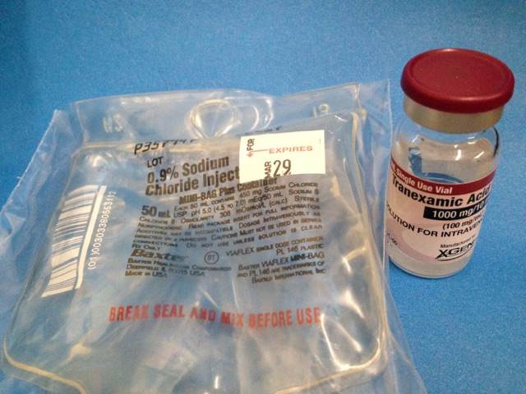
Medication Errors – Risk Management Analysis

Slide 15
Medication Errors – Other Cases and Causes
Increase in adverse outcomes involving mix-up of Neosynephrine and Reglan, Rocuronium and Versed, Rocuronium and Lidocaine
Look-alike and sound-alike drug names
Incorrect labeling; wrong doses
Lack of knowledge of patient’s history of reactions to drugs and antibiotics
Drug shortages

Slide 16
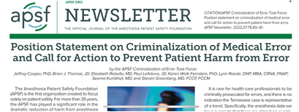
Medication Errors – Risk Management Strategies
Evaluate medication dispensing methods for high-risk drugs and current workflow to enhance safety checks prior to medication administration
Only use medication dispensing override when required in urgent or emergent situations
Except in case of emergency, institute double medication verification systems for all override pathways when removing medication from automated dispensing cabinets
Ensure appropriate monitoring of patients receiving high–alert medications
Deter a culture where “normalization of deviance” and the associated practices occur
https://www.apsf.org/wp-content/uploads/newsletters/2022/3703/APSF3703-2022-10-a01-PositionStatement.pdf

Slide 17
Medication Errors – Risk Management Strategies
Technology – Facilities should implement systems and processes including bar code scanning systems, computerized physician order entry systems and automated information systems
Collaborate – Clinical pharmacists should be part of OR team, prefilled syringes and pre-prepared medication kits should be used whenever possible
Culture – Create a Culture of Safety for reporting errors (including near misses), education, remediation, and accountability
READ THE LABEL CAREFULLY

Slide 18
Endoscopic Sentinel Events – PPM Loss Data
Increased number of claims and lawsuits arising from complications during endoscopic procedures; many resulting in catastrophic injuries, such as brain damage and death
12 closed claims with payments in the last 10 years (11 deaths, 1 brain injury):
    Indemnity payments = $8,576,500
    Defense costs = $972,579
4 pending lawsuits alleging patient death or brain injury during elective endoscopic procedure:
    Indemnity reserves = $2,450,000

Slide 19
Endoscopic Sentinel Events – Case Study
64-year-old male, ASA III d/t morbid obesity (5’10, 140 Kg, BMI 44), suspected OSA, DM, HTN, and diverticulitis presented for elective colonoscopy
MAC w/ sedation (propofol and lidocaine) O2 nasal cannula at 4L/min
During procedure, gastroenterologist noted irregular heart rhythm and hypotension followed by bradycardia
When lights turned back on, patient was noted to be cyanotic
O2 SAT was 75% and HR 49; mask ventilation started, O2 SAT 43%, bradycardia to asystole
Code called, patient resuscitated but never woke up; family removed supportive measures and the patient expired four days post-op
COD - hypercarbia, cardiac arrest, and anoxic brain damage

Slide 20
Endoscopic Sentinel Events – Expert Criticisms
Failure to secure airway with LMA or intubate due to high risk
Failure to use capnography or chart ETCO2
Failure to recognize and treat hypoventilation
Lack of vigilance
Gastroenterologist’s anticipated deposition testimony: Anesthesiologist was “not paying attention, talking too much, showing pictures of his grandchildren on his cell phone”

Slide 21
Endoscopic Sentinel Events
Risk Management Strategies
Consider whether patient appropriate candidate for planned procedure at the facility; document any discussions with the endoscopist in the medical record
If medically indicated, delay or cancel the procedure for further evaluation and treatment
Avoid IV general anesthesia with an unprotected airway, instead administer minimal or moderate sedation or general anesthesia via endotracheal tube or LMA
Deliver oxygen via non-rebreather mask with a sampling device used for qualitative ETCO2 measurement
Aggressive treatment of bradycardia

Slide 22

Distractions in Patient Care Areas

Slide 23
Distractions in patient care areas – Case Study
61-year-old female presented for atrioventricular (AV) node ablation and pacemaker lead revision under MAC with sedation
After the lead was sutured in place, the patient was noted to be cyanotic and the O2 SATs were decreased (78%-40%)
The anesthesiologist placed an LMA as the cardiologist expressed concern regarding the patient's color and the low O2 SATs
The anesthesiologist then intubated the patient, and a code was called after the patient was found to be in pulseless ventricular tachycardia

Slide 24
Distractions in patient care areas – Case Study
The patient was shocked and CPR continued; however, the patient expired
Cardiac tamponade was thought to be the COD
The patient’s family sued the cardiologist and the hospital for the wrongful death of the patient
During the cardiologist’s deposition nearly one year after the lawsuit was filed, he testified that the anesthesiologist failed to notice the patient’s dangerously low blood-oxygen levels until 15 or 20 minutes after she turned blue

Slide 25
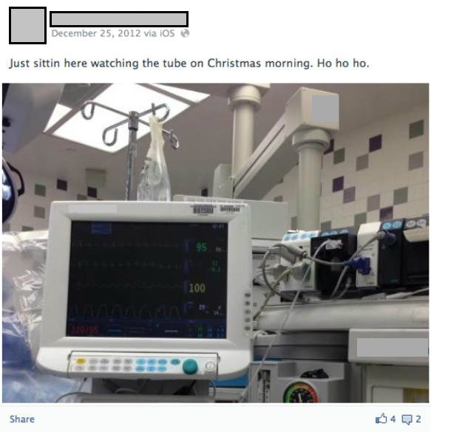

Slide 26

Distractions in Patient Care Areas – Evidence
Metadata and e-discovery
Phone data, text messages, and computer records are discoverable and may be admissible in litigation
Surgeons and OR staff members may provide harmful testimony if the anesthesia provider is distracted in OR
Inflammatory evidence of distractions in the OR may anger juries and result in punitive damages
Facebook and social media postings

Slide 27
Distractions in Patient Care Areas – Other Consequences
Suspension and non-renewal of privileges
State medical licensing board investigations/sanctions
National Practitioner Data Bank reporting
Significant negative media coverage
Public relations challenges
HIPAA violations

Slide 28
Distractions in Patient Care Areas
Risk Management Strategies
Review and comply with practice facilities’ PED policy statements, guidelines, and policies
Implement a “sterile cockpit” protocol during critical phases of procedures
Limit personal telephone calls and text messages to urgent or emergent situations
Keep telephone calls to a minimum and brief as possible
Avoid discretionary Internet-based activities
https://issuu.com/aanapublishing/docs/12_-_mobile_information_technology

Slide 29
Top 10 Lawsuits*
* PPM 2011-2020

Slide 30

THANK YOU!
Brian J. Thomas, JD
Vice President of Claims & Risk Management
brian.thomas@ppmrrg.com

