Slide 1

OANA 2025 Fall Education Conference
Office Based Dental Anesthesia Start Up
Copyright 2025. Stephen D. Smith MA, CRNA, FAANA. All Rights Reserved.

Slide 2
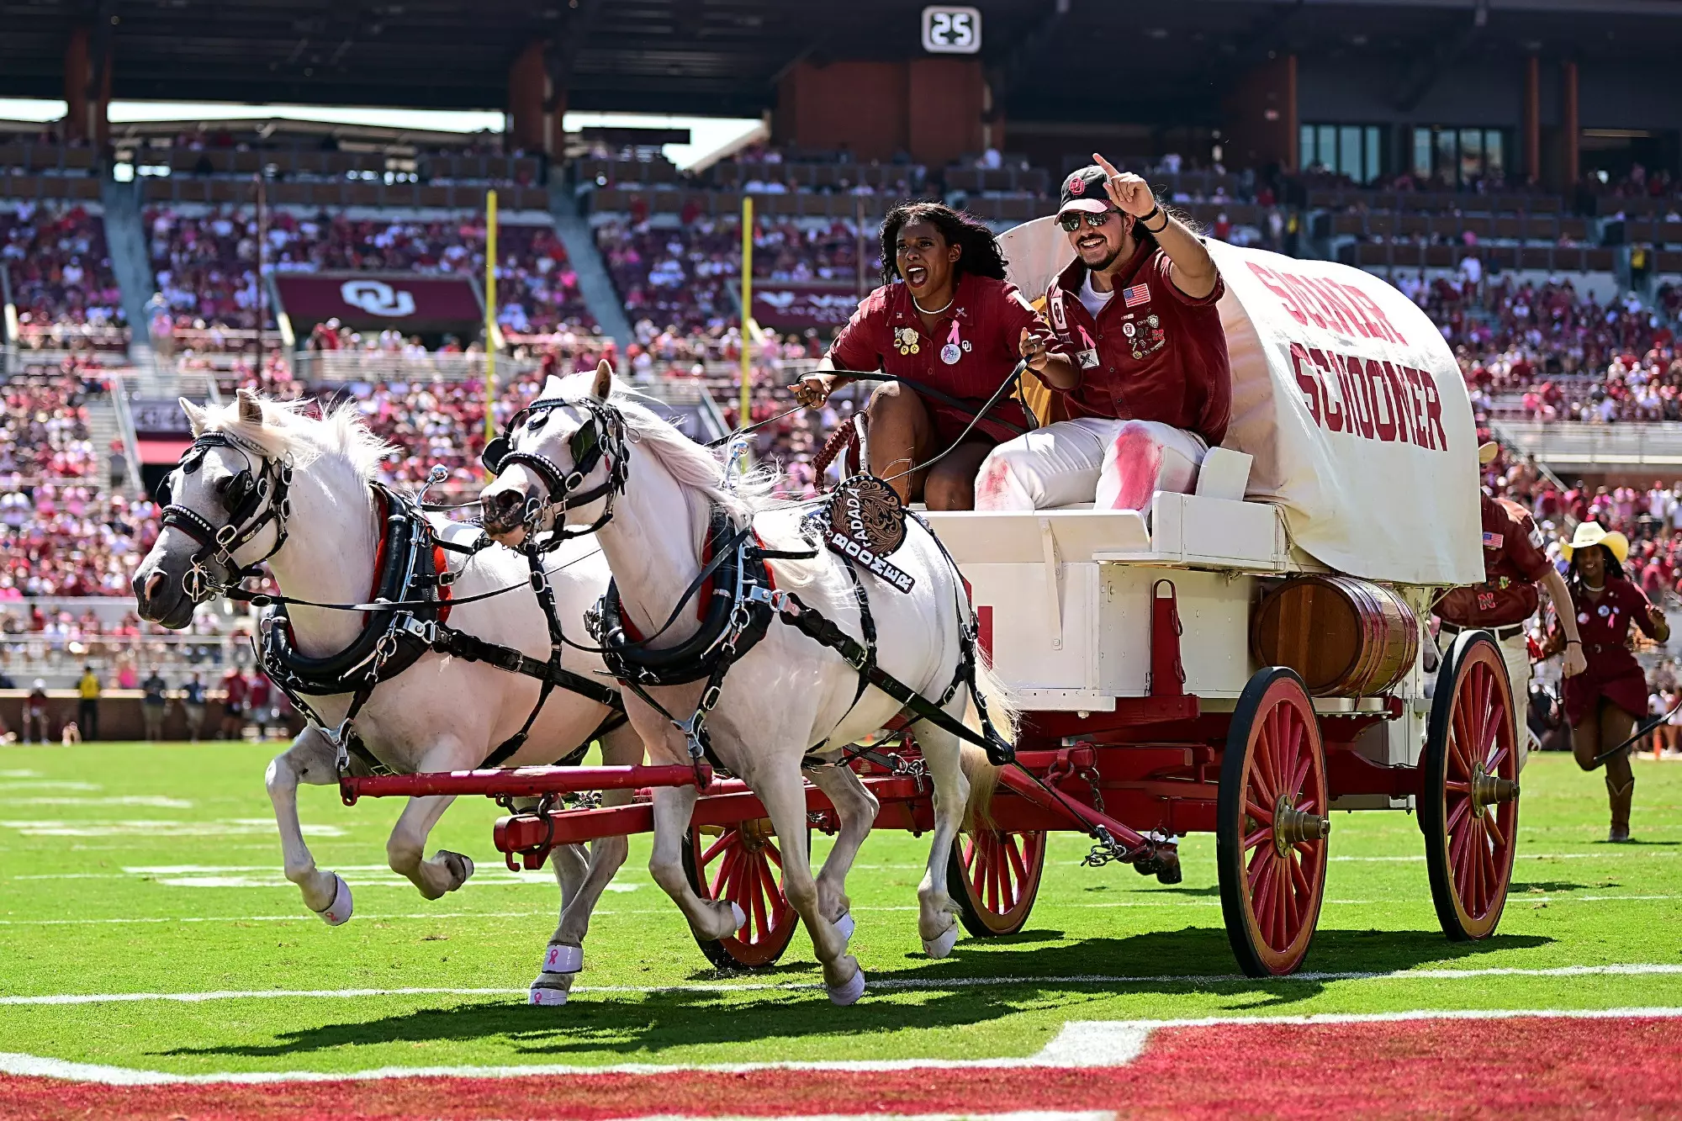

Slide 3




Disclosure Statement
Office Based Dental Anesthesia Start Up
Stephen D. Smith MA, CRNA, FAANA
I have no financial relationships with any commercial interest related to the content of this activity.
I will not discuss off-label use during my presentation.

Slide 4

Discuss starting up an office based dental anesthesia practice.
Explain billing and reimbursement related to dental anesthesia.
Discuss the different types of anesthesia utilized for office based dental anesthesia.

Slide 5

Discussion
Dental resources
Dental permits, regulations and legislation
Necessary anesthesia forms
W-2 employee vs. 1099 contractor
CPAs, attorneys, contracts, malpractice insurance and choosing a business structure
State practice laws
Market yourself
Dental billing and reimbursement
Template for supplies, equipment and drugs
Drugs and techniques for general anesthesia/NETT and IV sedation

Slide 6


Office Based Dental Anesthesia is the Low Hanging Fruit!
Do the simplest or easiest thing first that gives the best reward
Path of least resistance
Physician anesthesiologists don’t want these types of practices
“Cash is King”
Logistically, easy start up
Dental anesthesia tends to reimburse more than other cash pay office-based practices unlike plastics/cosmetics

Slide 7

AANA Dental Anesthesia Resources
https://www.aana.com/practice/clinical-practice-resources/dental-anesthesia-resources
https://www.aana.com/secure/2023/12/introduction-to-dental-anesthesia-business.pdf/
AANA SGA (Jana Conover and Ewa Greenier)
“CRNA’s and Dental Anesthesia”
*Get yourself a mentor or two – I will be glad to help

Slide 8
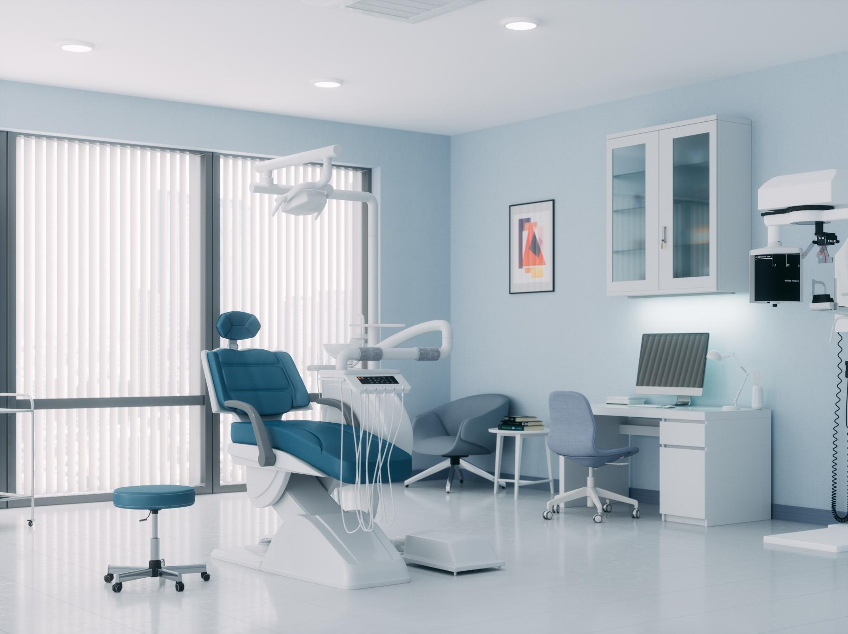
CRNA Permit Status Overview
State Regulation of CRNAs
  Each state dental board sets unique regulations for Certified Registered Nurse Anesthetists working in dental offices.
Supervision and Collaboration Requirements
  Some states allow CRNA participation only under specific supervision or collaboration agreements with dental practitioners.
Reviewing Board Guidelines
  It is crucial to review state dental board guidelines to ensure compliance with CRNA scope, permit, and application requirements.
Notes:
Image source: Microsoft 365 content library
State dental boards regulate the permit status for Certified Registered Nurse Anesthetists (CRNAs) practicing in dental offices. Regulations vary by state, with some permitting CRNA involvement under specific supervision or collaboration agreements. It is essential to review each state’s dental board guidelines for CRNA scope, authorization, and application requirements.

Slide 9
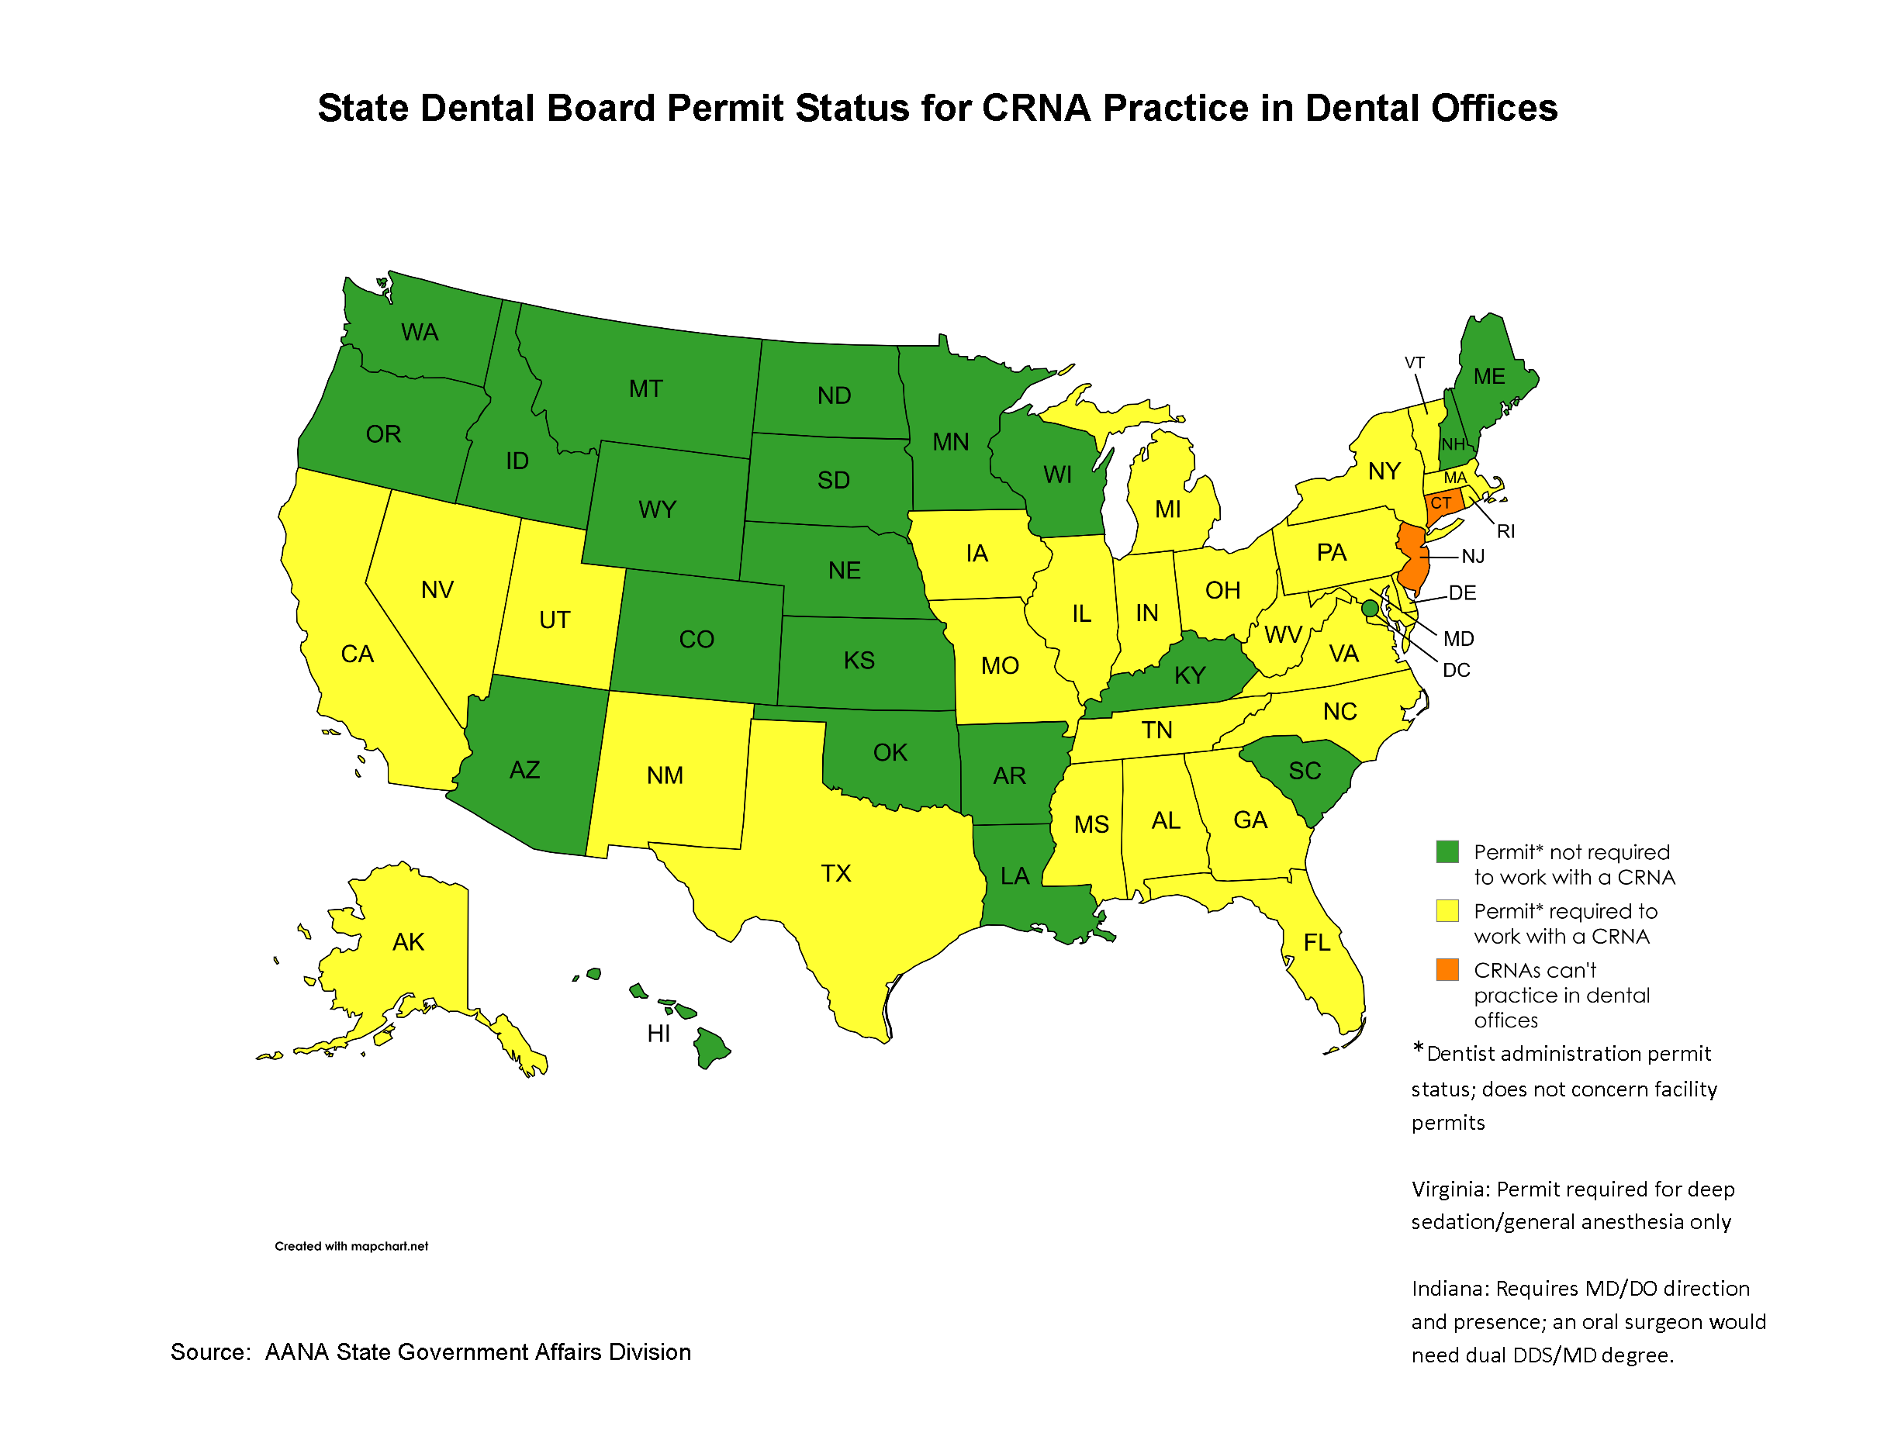

Slide 10

Anesthesia forms you will you need
Preop Anesthesia Questionnaire
Anesthesia Record
Consent

Slide 11


Transition for W-2 Employee to 1099 Contractor Pros and Cons

Slide 12
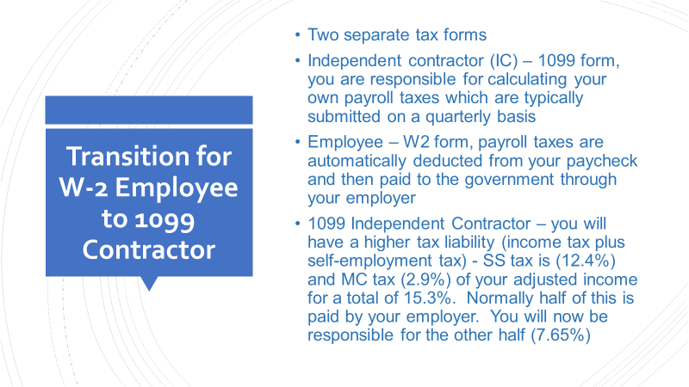

Slide 13
💼 Key Tax Responsibilities for 1099 Workers
1. Self-Employment Tax covers Social Security and Medicare.
Rate: 15.3% total (12.4% for Social Security + 2.9% for Medicare.
2. Federal Income Tax based on your total taxable income after deductions.
You can reduce liability through: Standard or itemized deductions, business expenses (e.g., equipment, travel, home office) and retirement contributions (e.g., SEP IRA, Solo 401(k))
3. State Income Tax varies by state.
4. Quarterly Estimated Payments due in April, June, September, and January.

Slide 14

Potential Benefits Lost by not being a W-2 Employee
Paid SL, VL, health, dental, disability, malpractice insurance, retirement/pension, unemployment benefits, workman’s comp, meeting time off with compensation, professional dues and no more OT pay.
According to the Bureau of Labor Statistics, 29.7% of your total compensation package is in benefits.

Slide 15

1099 Advantages
Pay rate higher due to fewer costs
No weekends, call, or holidays
Deductions - auto, home office use, meals, marketing, ads, gifts, computers, office supplies, phones, internet, CEU’s, meetings, health and malpractice insurance (not disability premium but if you need the benefit, it will be tax free)
SEP/IRA - Contributions an employer can make to an employee's SEP-IRA cannot exceed the lesser of 25% of the employee's compensation, or $70,000 for 2025.
Best benefit – being your own boss! Having independence and control over your own destiny not to mention not having to answer to a physician anesthesiologist!

Slide 16

AANA 2025 CRNA Compensation and Benefits Survey
(2024 data)
The median total compensation from all employee arrangements (includes income and not benefits) for full-time employees in 2024 was $270,000; this is up from $251,000 in 2023, an increase of about 8%. Hospital employees made up 38% and independent contractors 20%
The 25th percentile was $235,000 and the 90th percentile was $380,000
The median compensation for self-employed CRNAs was $314,000
Hospital employees had a median compensation of $280,000

Slide 17



Will you need a CPA, Attorney and Contracts?

Slide 18


YES! YES! and YES!
Try to find one with a history of working with an anesthesia provider if possible
Try to get contract with each practice as to include “confidentiality and non-solicitation of employees”
Critical to have a contract with each of your employees that includes a “restrictive covenants clause or non-compete clause”

Slide 19

Contracts
We encourage a contract; it has the perception of ownership for both parties
Reduces the risks of legal action
Provides clarity – outlines exactly what is expected of both parties
Will need a contract with both the practice and your employee
A contract between partners is an absolute necessity

Slide 20
“Non‑competes aren’t enforceable; just ignore them.”
Depends on the language of the non-compete clause, the applicable statutes and case law in your state, and the specific facts of your situation. Even if a judge eventually rules that a clause is unenforceable, getting to that decision could take years and rack up six‑figure legal fees.

Slide 21

It’s critical to find a good mentor or two!
So along with a contract, CPA and attorney you will also need malpractice insurance, possibly or potentially a billing service and choose a business entity.

Slide 22

Choosing your business structure

Slide 23

Sole Proprietorship, Limited Liability Company (LLC), Partnerships and S Corporations

Slide 24

Limited Liability Company (LLC)
A business entity that is separate from its owners, like a corporation
Unlike a corporation, which must pay its own taxes, an LLC is a “pass through” tax entity.
The profits and losses pass through to its owners who report them on their personal tax returns
An LLC is not a corporation, it’s less complex and requires less paperwork that a corporation
Like shareholders of a corporation, all LLC owners are protected from personal liability for business debts and claims but not personal injury

Slide 25
S Corporations
An S Corporation is the same as any other corporation except for the way it is taxed.
They do not pay federal income tax but pass the tax liability for their profits through to their stockholders.
Prevents double taxation that regular corporations pay.
Advantage over LLC’s - Distributions made to S corp shareholders are not subject to Medicare and Social Security taxes (FICA). The IRS still requires you to pay yourself a “reasonable” salary. ($235K)
Disadvantage vs. an LLC – there are higher legal and tax service costs, must file articles of incorporation, hold directors and shareholders meetings, keep corporate minutes and allow shareholders to vote on major corporate decisions.

Slide 26

Whichever structure you choose you will obtain an EIN or employer identification number (tax ID #) used to identify your business entity and for tax purposes. You will also file an annual registration with the office of the SOS

Slide 27
State Practice Laws
You must know your state laws!
In Georgia we practice under 4 state laws; the Nurse Practice Act, the Medical Practice Act, the Dental Practice Act and the Podiatry Practice Act.
Georgia Registered Professional Nurse Practice Act
(43-26-11.1) anesthesia may be administered under the direction and responsibility of a duly licensed physician (MD or DO).
Medical Practice Act
(43-34-23 and 43-34-25) this has to do with protocol language, one for prescriptive authority and one that does not contain this language

Slide 28
Dental and Podiatry Practice Act
Dental Practice Act
(43-11-21 and 43-11-21.1) CRNAs can give IV sedation if the dentist has an IV conscious sedation permit and GA if they have a general anesthesia permit which requires 1 year’s training in anesthesia or is an oral surgeon
Podiatry Act
(43-35-1 — 43-35-18) We can give IV sedation but not GA. It’s a bit ambiguous but we practice in the capacity of an RN.
State Opt-Outs – 2001 CMS Rule to present – Georgia is not
So according to Georgia state law, there is no requirement that the physician provide direct or onsite direction. With Medicare part A (cop and cfc) it does require direct supervision of an anesthesiologist or the operating practitioner unless you are an opt out state, which Georgia is not. To date, 25 states and Guam have opted out of the federal physician supervision requirement.
Can CRNAs still practice and bill independently, yes!

Slide 29
Notice of Intent to Amend Rule of the Georgia Board of Dentistry
Rule 150-13-.01 Conscious Sedation Permits
(Moderate Parenteral Conscious Sedation Permit)
The public hearing took place July 12, 2024
We practice under the direction and responsibility of a dentist duly permitted
Permit – completion of 60 hours of didactic with 20 hours in person and 20 adult patient experiences
Moderate conscious sedation is defined as a drug-induced depression of consciousness during which patients respond purposefully to verbal commands, either alone or accompanied by light tactile stimulation. No interventions are required to maintain a patent airway.
“No restriction on meds” but based on a sedation continuum. The dentist must submit documentation of any drugs they are using or any new ones they add.
Nothing in this rule is intended to restrict the pharmaceutical armamentarium of a CRNA when anesthesia is administered and monitored by a CRNA in conjunction with a dental procedure.

Slide 30
Types of practices in the office-based setting
ENT, GYN, Urology, General Surgery, Vascular, GI, Ophthalmology, Cosmetics and Plastics, Reproductive Medicine, Dermatology, Dental and Oral Surgery, Orthopedics, Pain Management and Ketamine Clinics
By not diversifying you worry about changes in legislation, regulatory changes and reimbursement that could impact your practice. (Pain and GI)
Diversify!

Slide 31

Market Yourself
Google ad words
Hand out lots of business cards
Exhibit at conferences and trade shows
Build a good website
Letters
Word of mouth by staff and reps
Our niche is small practices and flexibility in scheduling
Be in network 100%!
2021 surprise billing consumer protection act

Slide 32
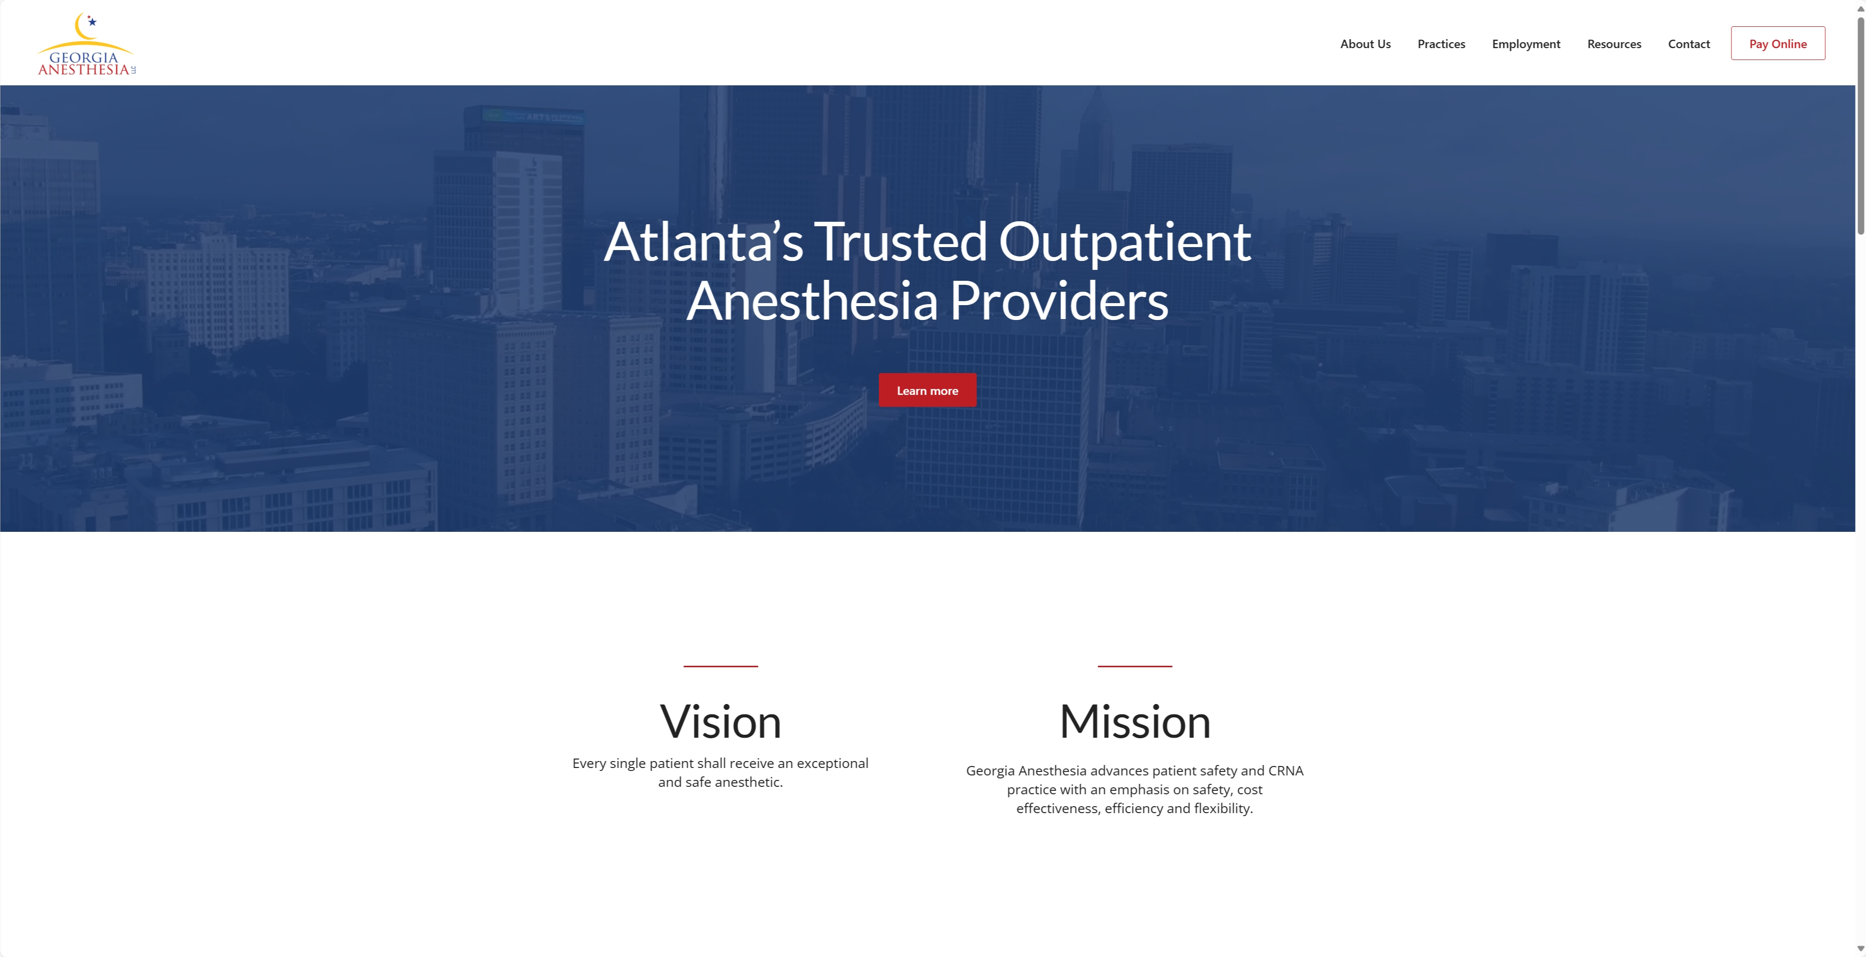

Slide 33

Dental Billing and Reimbursement
Many insurers do not cover dental anesthesia treatment.
During initial employment discussions, establish the reimbursement arrangement for your practice.
Will the CRNA be paid hourly, and the dentist handles the collection for anesthesia?
Will the CRNA bill separately for the anesthesia portion of the procedure? Medicaid vs dental insurance
Establish a fee schedule, be aware that there is regional variation in fees.
Establish collection method for self-pay patients.

Slide 34
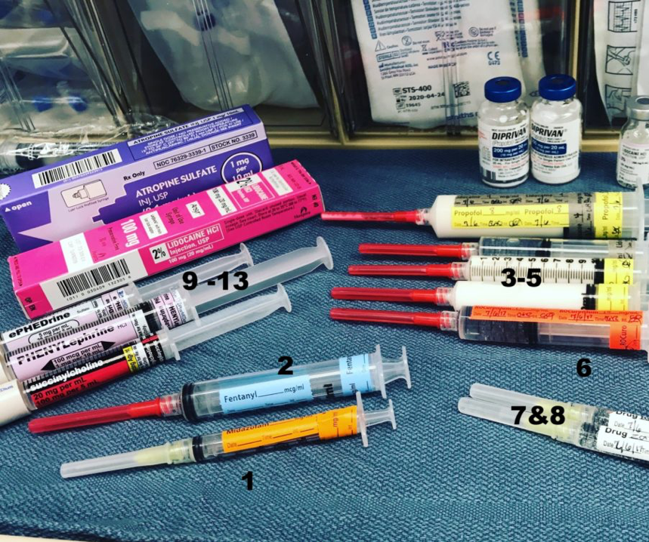
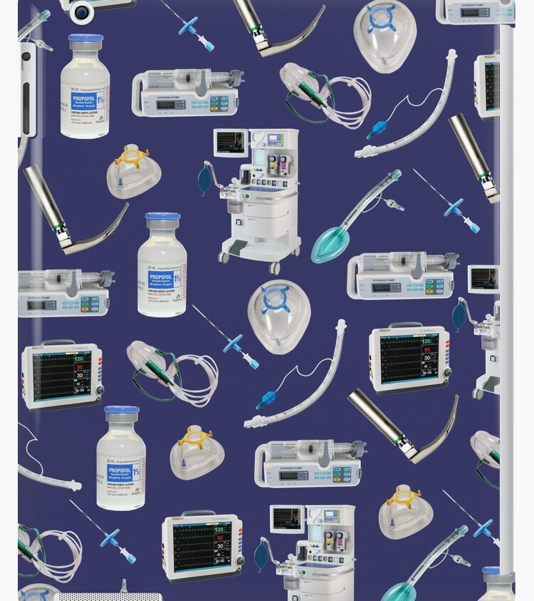
Supplies, Drugs and Equipment

Slide 36
Georgia Anesthesia LLC Supplies for IV Sedation
Supplies
Oral Airways (80, 90, 100mm) (1 box of each)
Nasal Airways (30 and 34 French) (1 box of each)
Ethyl Chloride Spray – Medium Mist (1)
Transpore 1-inch Tape (1 box)
Tegaderm for IV sites (1 box)
Syringes with 20-gauge 1-inch needle – 3ml, 5ml, 10 ml, 20ml (1 box of each)
TB syringes with 28-gauge needle as one unit (1 box)
Needles – 18, 20, 22, gauge 1.5 inch (1 box of each)
LR 500ml and 250ml (1 case of each)
Primary IV set – 15 drops/ml (must be needleless system with 2 ports) (1 case)
IV tourniquets (1 box)
Sharps box (2)
EKG pads (1 box)
Alcohol pads (1 box)
Safety IV Catheters – 20 and 22 gauge 1 ¼ inch (1 box of each)
O2 Nasal Cannulas with ETCO2 connection (1 case)
Portable Oxygen tanks with regulators – 2 H tanks and 2 E tanks for the OR and PACU
Glucose Meter (1)
Urine Pregnancy Tests
BP, EKG, ETCO2 and O2 Saturation Monitor for OR and PACU

Slide 37
Drugs
Propofol – 20ml Vials (25), Fentanyl – 2ml amps (25), Versed – 1mg/ml (2 ml vials) (25), Lidocaine 2% (5), Ondansetron – 4mg/2ml (25), Phenergan – 25mg/ml (5), Dexamethasone - 10mg (25), Robinul - .2mg/ml (3), Ketamine – 50mg/ml (10), Narcan - .4mg/ml (2), Romazicon - .1mg/ml (5), Rocuronium 100mg (1)/Sugammadex 200mg (5) and Toradol – 30mg/cc (25), Benadryl 50mg - 10
Precedex (dexmedetomidine) 200 mics (10)
Tylenol 500mg capsules – 1 bottle, Gabapentin tablets 300mg – 1 bottle, Clonidine tablets .1mg 1 bottle
Emergency Equipment
Endotracheal Tubes with Cuff – 6.0 and 7.0 (2 of each)
Stylet (1)
LMA - #3, 4 and 5 (1 of each)
Laryngoscope blade and handle – Mac 3 and 4, Miller 3 (1 of each)
Adult Face Mask with Ambu Bag (1)
Non-Rebreather face mask (1)
Suction with Yankauer suction tip for OR and PACU
AED
Flashlight

Slide 38
Georgia Anesthesia LLC General Anesthesia Supplies and Drugs
Supplies and Equipment
Anesthesia Machine (refurbished Datex Ohmeda Aestiva 5 with PSVPro ventilator) with monitor for vital signs, gas analysis and an evacuation system
2 Oxygen and 1 Nitrous H cylinders with 2 regulators from gas supply company
2 Oxygen and 1 air E cylinders for back of anesthesia machine
Portable suction machine
Yankauer suction tips (one box) and 1 box #14 French suction catheters
Portable Oxygen tank with regulator and vital signs monitor for PACU
AED
Ambu bag for the OR and PACU
Flashlight
Warming blanket and sequential compression devices (SCD) for legs
1 box of anesthesia breathing circuits with 3 liter reservoir bags
Large and medium adult face masks
Endotracheal tubes with cuff 6.0, 7.0, 7.5, and 8.0 (one box each)
Endotracheal tube stylets (1 package) and esophageal stethoscopes (1 package)
Laryngoscope Handles (2) and blades – Macintosh 3, Macintosh 4, Miller 2 with extra light bulbs and batteries
LMA – size 3, 4, and 5
Soda lime CO2 absorbers (1 box)
Temperature strips
Endotracheal tube tree and mask strap
Lacrilube for eyes and water soluble jelly for endotracheal tubes
Humidivents

Slide 39
Georgia Anesthesia LLC General Anesthesia Supplies and Drugs
Supplies and Equipment
Oral airways (80, 90, 100mm) one box of each
Nasal airways (30 – 32 French) one box of each
Ethyl Chloride Spray – Medium Mist (1)
Transpore 1 inch Tape (1 box)
Tegaderm for IV sites (1 box)
Syringes - 3cc, 5cc, 10 cc, 20cc (1 box of each)
Needles – 18, 20, 22, gauge 1 inch (1 box of each)
IV tourniquets (1 box)
LR 250 ml (1 case) or NS 250 ml (1 case)
Primary IV set – 15 gtts/cc (must be needleless system) (1 case)
Sharps box (2)
EKG pads (1 box)
Alcohol pads (1 box)
IV Catheters – 20 and 22 gauge 1 ½ inch (1 box of each)
O2 Nasal Cannulas with ETCO2 adaptor (1 case)
Non-rebreather face masks
Glucose Meter / Urine Pregnancy Tests
Drugs
Propofol – 20cc Vials (25), Fentanyl – 2cc amps (25), Versed – 1mg/cc (2 ml vials) (25), Precedex (dexmedatomidine) 200 mics (10), Lidocaine 2% 50 ml (3), Ondansetron – 4mg/2ml (box of 25), Phenergan – 25mg/cc (5), Robinul - .2mg/cc (5), Neostigmine 10mg (2) or Sugammadex 200mg – 5, Ketamine – 50mg/ml (5), Narcan - .4mg/ml (2), Romazicon - .1mg/ml (2), Succinylcholine – 20mg/ml (5), Toradol – 30mg/cc (25), Rocuronium 50mg vials (10), decadron 10mg/cc (25), Reglan 10mg/cc (2) and Dantrolene/Ryanodex with sterile water, Tylenol 500mg capsules – 1 bottle, Gabapentin tablets 300mg – 1 bottle, Clonidine tablets .1mg 1 bottle

Slide 40
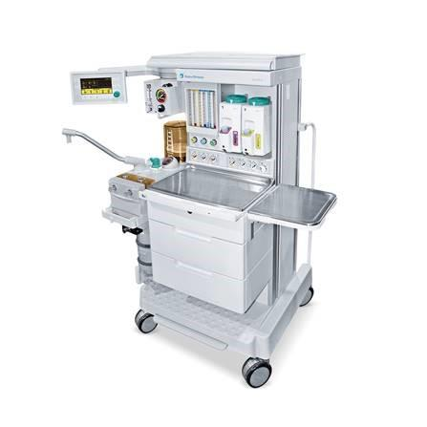
General Anesthesia for Office Based Dentistry
Datex Ohmeda Aestiva/5 Anesthesia Machine w/ 7900
PSVPro ventilator (Refurbished)

Slide 41
Drugs and Techniques for General Anesthesia/NETT
“what works for me may not work for you”
Afrin nasal spray in the holding area
NETT – room temp (in other words cold and firm) 6.0-6.5 for most women and 7.0-7.5 for most men
Induction – at least 100–150 mics of Fentanyl, 2-3mg/kg of Propofol (esmolol if needed up to 1 mg/kg), Lidocaine 1.5mg/kg, if airway ok prefer Rocuronium for a slower induction. Once asleep more Afrin nasal spray, eye ointment for the longer cases. Maybe most important, use a VL of choice (Uescope) for all intubations. Make sure NETT is not causing pressure on nose and check periodically. Keep cuff as loose as possible without a leak.
Maintenance – 8-10mg of Decadron during or right after induction, Sevoflurane, keep systolic BP around 100 for bleeding. Not uncommon to give 10-20mg of Labetalol during the case. At some point during the case give Toradol and Zofran. * use SCD’s
IV Fluids – 250ml of NS or LR, I don’t catheterize anyone even on long cases, so I keep my fluids to a minimum, around 500ml for a 4-6 hour case. IV tubing needs a port at top.
Wakeup – on long cases, last 30-45 minutes or so, discontinue the Sevoflurane and go to 70/30 N2O/O2 and titrate Propofol and then another 1.5mg of Lidocaine IV before extubation.

Slide 42
IV Sedation – “Less is More”
Drug choices - dependent on state law/supervision
Monitoring – ETCO2 standard of care
Prior to local – Versed 3-5 mg, Ketamine 25-50mg, Benadryl 25mg, Fentanyl 50mics, titrate more Versed if needed. Still want them to be able to follow commands. Do Not let the dentist localize until BP and HR normal!
After local, I rarely give anymore Fentanyl. Titrate Versed as needed and if longer case give another 25mg of Benadryl. Can give Toradol and Zofran and Decadron.
Robinul? – personally, I rarely if ever use it, just don’t see need with continuous suctioning plus the Benadryl will dry them out
Precedex or Propofol - if needed for deeper sedation or if intolerant to Versed.
If using Precedex, for longer cases 1mic/kg over 10-15 minutes and then 1mic/kg/hour. For shorter cases 10-20 mic boluses, works great. Remember, if you are using as an infusion give it at least 30 minutes or longer to wear off before wakeup.
Keep it safe – Remember, shared airway with throat packs involved, make sure they can protect their airway if possible!
Have patient awake at the end, recover 10 minutes and d/c per dentist, I don’t hesitate to give Romazicon if needed, .1-.2mg.

Slide 43

Weigh the positives and negatives of starting your own OBA practice. Transition if possible.
First things first, you will need malpractice insurance, CPA, Attorney, contracts, billing service and choose a business entity.
It’s critical to find a good mentor or two.
Utilize the www.aana.com for information like documents, resources and legal information.
Know your state and federal laws.
Make sure all equipment, supplies and drugs are in place
Start a website and market yourself.
Remember, easy does it, all of this does not have to happen over night.

Slide 44
References
AANA – Dental Anesthesia - https://www.aana.com/practice/clinical-practice/clinical-practice-resources/dental-anesthesia/
Georgia Registered Professional Nurse Practice Act (43-26-11.1) https://sos.ga.gov/sites/default/files/forms/38%20Reference%20-%20Nurse%20Practice%20Act.pdf
Georgia Medical Practice Act – (43-34-23 and 43-34-25) https://medicalboard.georgia.gov/sites/medicalboard.georgia.gov/files/related_files/site_page/Medical%20Practice%20Act%202013beta.pdf
Dental Practice Act (43-11-21 and 43-11-21.1) https://gbd.georgia.gov/sites/gbd.georgia.gov/files/related_files/document/Title%2043%2C%20Chapter%2011%20-%20Dentists%2C%20Dental%20Hygienists%2C%20and%20Dental%20Assistants.pdf
Chapter 35 - PODIATRY PRACTICE (§§ 43-35-1 — 43-35-18) - Section 43-35-3 – Definitions
https://law.justia.com/codes/georgia/title-43/chapter-35/section-43-35-3/
AANA 2025 - Practice Profile and Compensation & Benefits Member Survey - file:///C:/Users/user/OneDrive/Desktop/Compensation%20and%20Benefits%202024%20Report%20for%20Publication%20(1).pdf
Notice of Intent to Amend Rule of the Georgia Board of Dentistry – Rule 150-13-.01 Conscious Sedation Permits - file:///C:/Users/user/Downloads/Notice%20of%20Intent%20to%20Amend%20Rule%20150-13-.01%20-%2006.12.2024%20(12).pdf

Slide 45

Stephen D. Smith MA, CRNA, FAANA steve@georgiaanesthesiallc.com
404-429-8553

Slide 46

OANA , CRNAs and Residents

Slide 47

Questions

